Slide 1
Charting a course through a career in hydro
New Zealand Hydrographic Authority
Brad Cooper
Senior Hydrographic Surveyor
08/08/2022

Slide 2
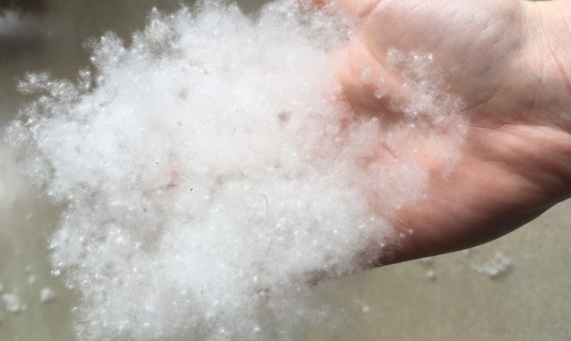
Introduction
📷 Credit: Name
Notes:
I would much rather be talking about a technical topic like how we reran the risk assessment or how we can use IceSat2 data to ground truth SDB
This isnt my strong point talking about the intangible, im here to talk about something a bit fluffy
I think its something that a lot of people who start their careers in technical roles struggle with but will talk more on that later
So will take a set course to uncharted waters…start by talking about my career so far, some recent events that have shaped it and then end with some reflection

Slide 3
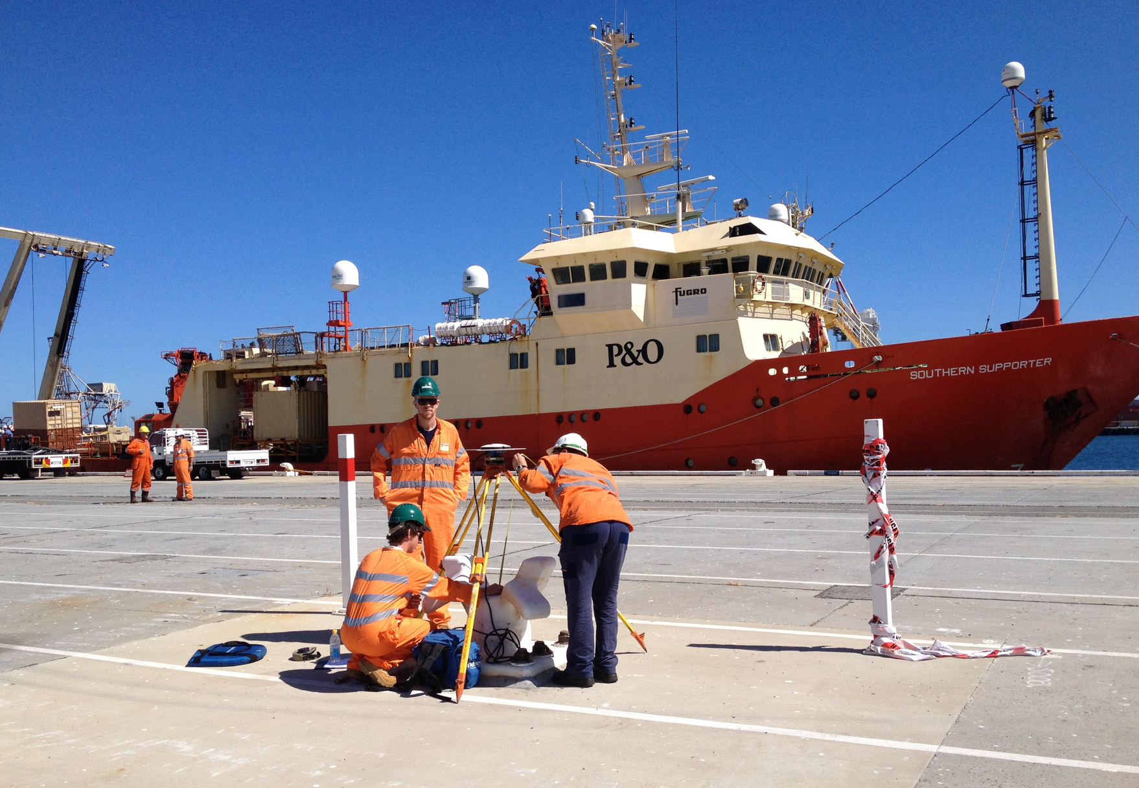
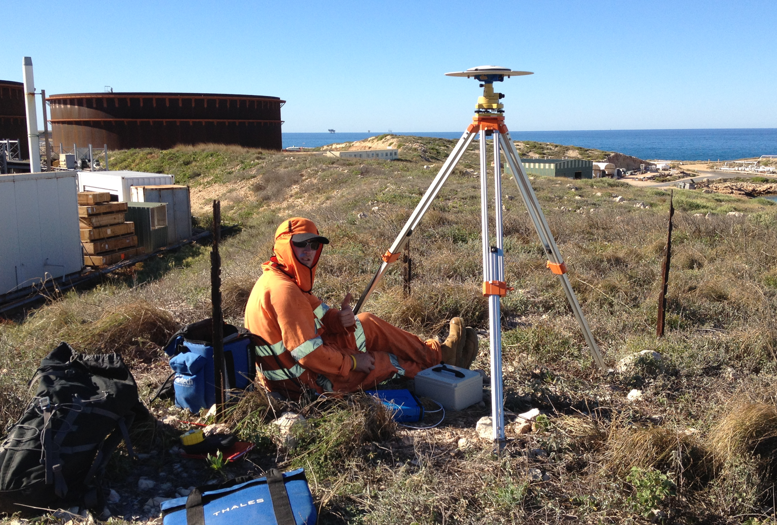
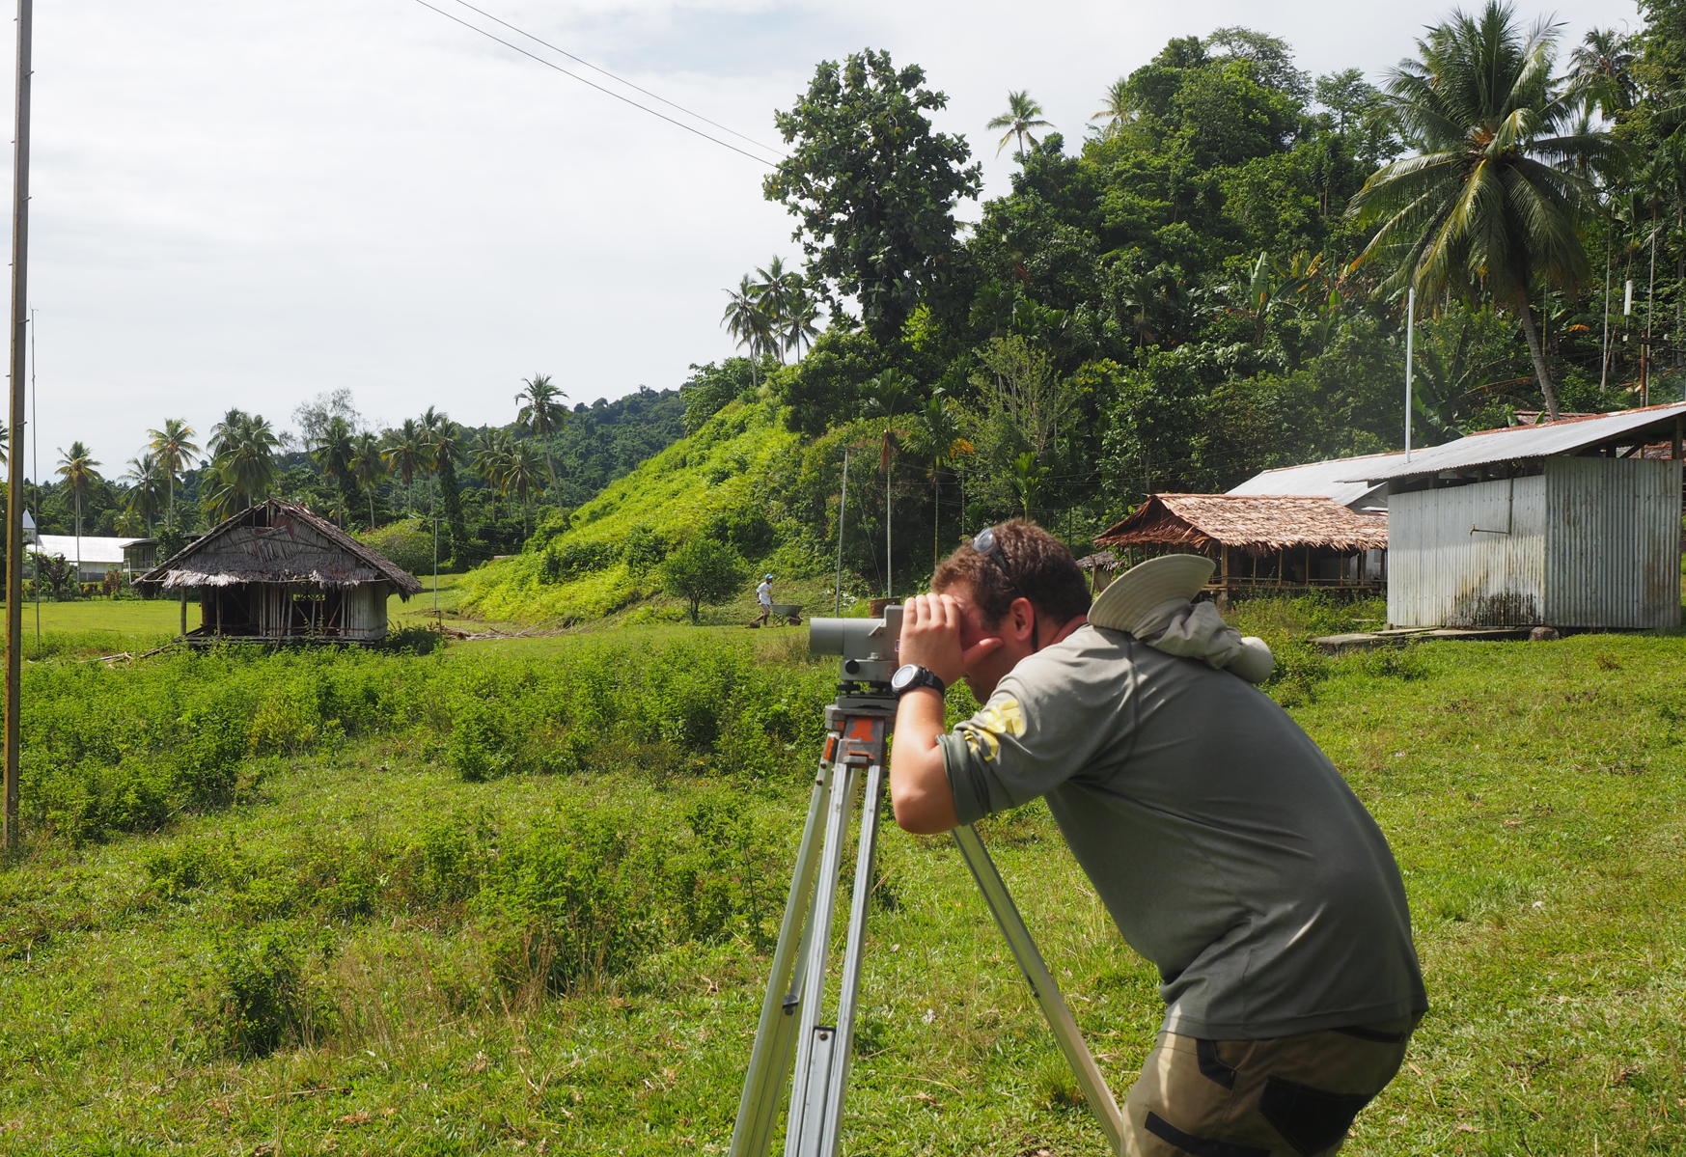
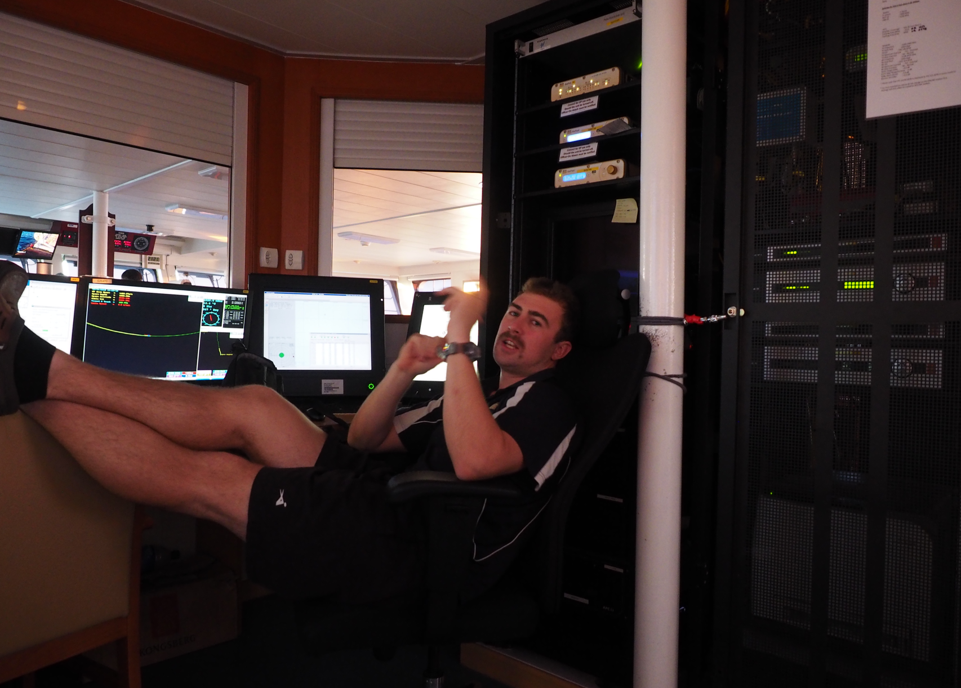
Early Career
Notes:
Few years into my surveying degree found out about hydro, hadn’t spent much time on boats, but had an interest. Had me at travel.
Graduated end of 2011 (BSurv 2010 + Postgrad in 2011 with Cat A). That last year appealed as I wanted to climb/tramp more
exodus to Aus (50k net leaving in the month I left)
Joined the mass leaving NZ
Felt like there were more opportunities in Aus. Didn’t really know much about the industry. Aware of local companies but weren’t sure if the work was there. These were the days before HYPLAN and HIPP
4 of us went to Perth to join Fugro
7 years working for Fugro Perth office. Good opportunities. to do variety of work Mixed model of work offshore+office, good opportunity to build reporting and processing skills, not typical as most work offshore.
Model of offshore surveyor vs offshore processor, we were taught to do both
Software development in house, geophysical, offshore construction/metrology (ROV, USBL ,LBL), dredging support, rig moves, nautical charting, plane searches…
NZ was always home. In sept 2018 I made the move home.
A mate spotted the LINZ job, looked at the job description and thought “that sounds like me”
Reasons for moving:
-wanted more ability to plan my life, it is one of the downsides of offshore work
-move home closer to friends and family
-felt like a change, sort of reached in a point where I was doing the same thing
-escape the Perth heat

Slide 4
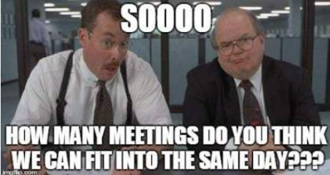
Move to LINZ
Notes:
BIG ADJUSTMENT from working in private sector to public. Went from 1 or 2 meetings in a week to 20hrs of meetings. Involved in higher level discussions.
Never heard of terms such as agile or production/dev before. New ecosystem
Busy start, had 3 surveys delivered, one of which was a multi sensor which needed to be handled in a particular way, learning as we went.
Also feel I arrived at the right time to add something, had collected datasets for multiple purposes before, already had interest in multi sensor surveys being involved in one overseas.

Slide 5
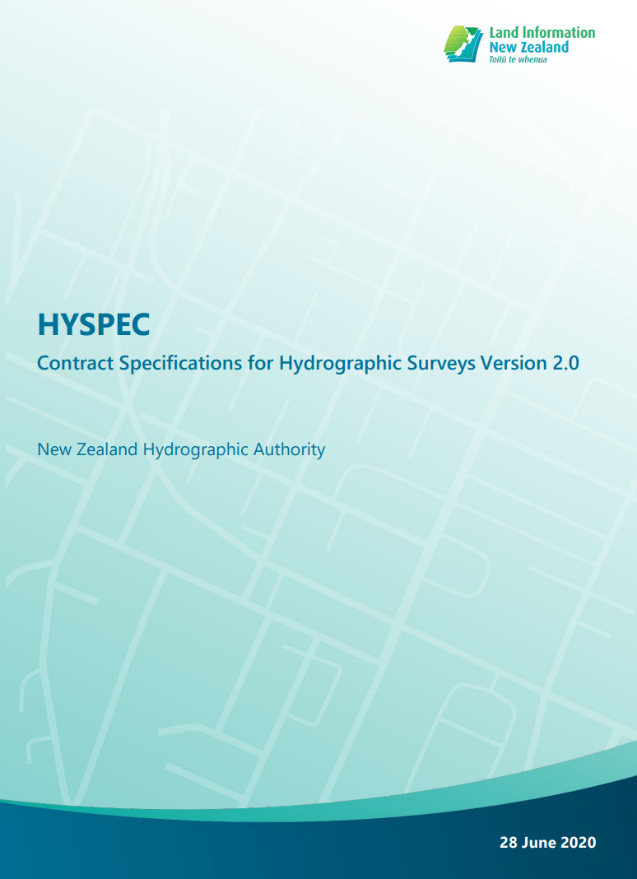
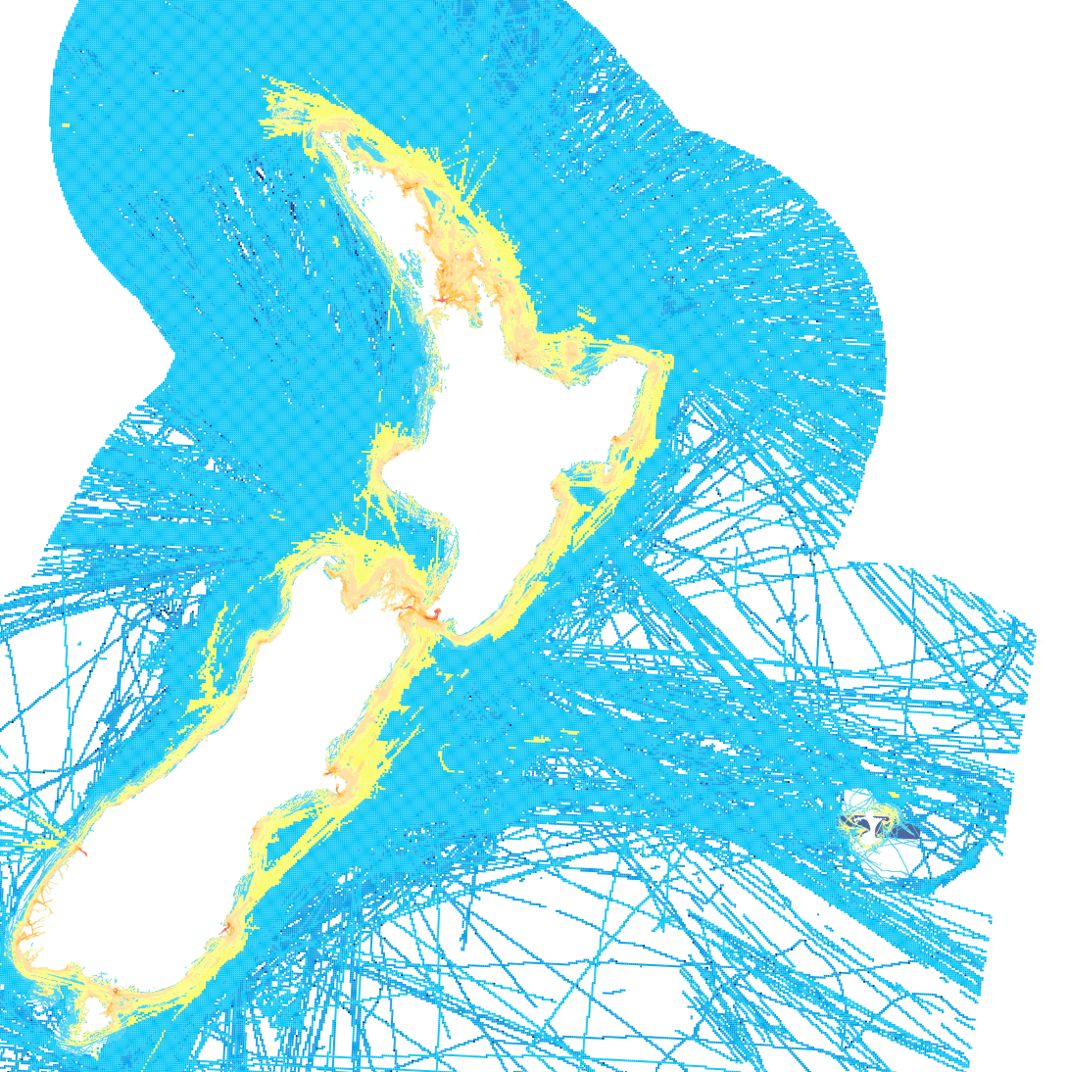
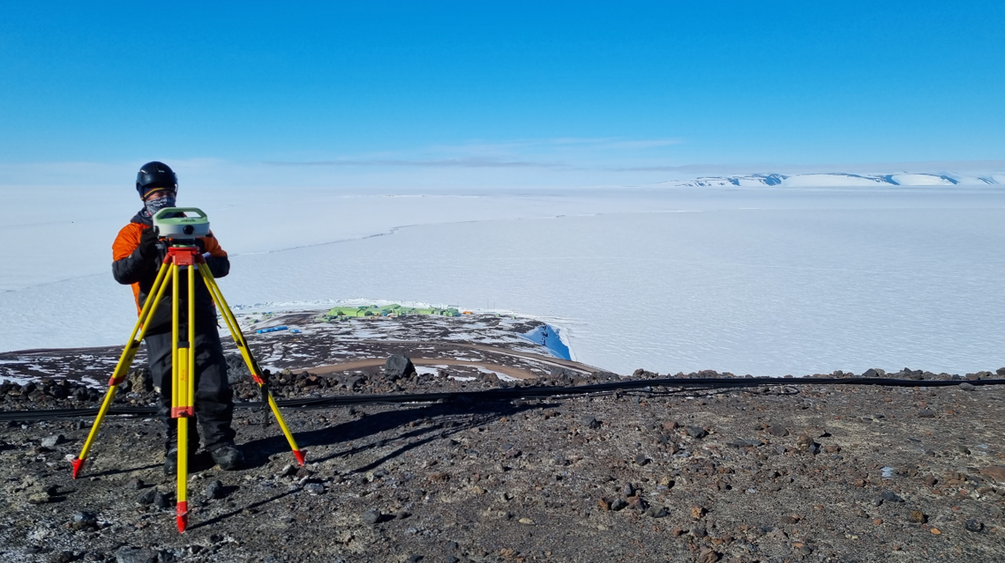
Work at LINZ
Notes:
Multi faceted. Small team where everyone wears many hats.
Qcing data, contract management, investigating existing data in Bay of Islands one hour, investigating source data in the SW pacific the next, investigating an NTM, stakeholder engagement…
Had some good opportunities, a trip to the ice, re-writing HYSPEC, HYPLAN programme, survey partnerships, getting into multi sensor surveys. More recently coastal mapping/emergency response
With so much going on its difficult to look up and plan at times and it requires conscious effort to look up and plan.
Very much change in working is required. Planning instead of doing, collaborating more, perhaps talking a bit more which comes with the territory of being answerable to a larger amount of people

Slide 6
Hydrographic Leaders Programme
Notes:
In early 2022 the SWPHC developed the hydrographic leaders programme. Was encouraged to apply.

Slide 7
About the programme
The aim of the program is to increase the confidence and motivation of participants to:
Lead hydrography work in their region, including formal leadership roles.
Represent their region and nations at international fora.
Increase their visibility through this program.
This is done through:
Weekly cohort meetings
Mentoring relationships
Technical Workshops (e.g. Law of the Sea,
Hydrographic Governance)
“Soft skill” Workshops (e.g. “Right Conversation”)
Guest speakers (e.g. SWPHC Steering Group members,
and Abri Kampfer Director IHO)
Leadership Development Programme
Outputs and Outcomes
Technical and behavioural skills and knowledge input
Monthly workshops
Guest speakers from international and industry regulators, defence and politics
Processes for making sense of and applying learning
Cohort weekly meetings
Mentoring Programme
Action Learning / Project Meetings
Programme management, active engagement of key stakeholders.
Programme learning, monitoring, evaluation and reporting
Notes:
Good to build relationships with other people across the region, never really attended commission meetings
Mentoring was useful, paired up with a leader. I used it as a chance to discuss my work challenges, think at the time I was asked to be
Guest speakers on different parts of the hydrographic governance (IHO, RHCs)
Soft skills - effective conversations is a good toolkit

Slide 8
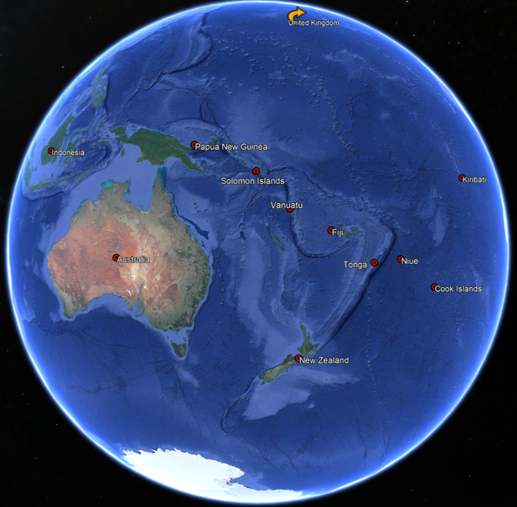
About the programme (cont)
Notes:
“Mutually inconvenient times” – inside no ones work hours
16 participants from 12 countries
Really diverse group in terms of context, experience, expertise and through the programme we learned from each other and shared ideas, problems and solutions.
We were tasked with preparing a presentation in the end about the challenges facing island nations in a hydrographic sense
Had some good long and candid chats in a few meetings these challenges and how to solve them
Good to be involved in these things early if you are going to lead or actively contribute in any effective way
Law of the sea we covered at uni, hydrographic governance not so much. Interesting covering it formally when you work within that ecosystem, really helps it sink in and lets you understand the nuances of things
Good to build relationships with some clever people across the region and at PCAs. Sailing directions/MSI
Formal training is a good thing/cant rely on school of hard knocks.
Theoretical content of the course was useful
Found my mentor easy to talk to and very informative

Slide 9
General Reflections
Hydrographic surveyors are technical people – as you move through your career skills need to be changed. Happens in the field and in the office.
Tendency to go back to old ways…
You need the right type of work to develop/also need to apply yourself too!
Exposure to things early helps
Careers aren’t talked about - its not obvious what opportunities are out there
Speak up!
Where to next?
Notes:
Typically you start your career and it’s the technical skills that get valued and developed, add to that you likely gravitated to it due to its technical nature
I find its hard to drop the technical side and think up and out. Requires conscious effort to tear yourself away from that work.
There needs to be opportunities to develop. One example of this is we need hydro surveys in the region to develop ppl and build capacity. It’s a two way street.
Exposure to things early helps – attending conferences, meetings before you are in the position where you lead them, think I attended 1 AHS meeting before I was chairing it, difficult to lead, cart before horse
I don’t think its very obvious for people starting in their career what options are available and think that’s why a lot of ppl leave. More talk around that can help guide people, keep them engaged, keep them in the industry

Slide 10
This slide has been intentionally left blank
Notes:
Ive left this blank for effect.
Who really knows, but there are options.
I think there are opportunities there in hydro, with the rate of technological change it will create more and more roles, roles ppl with a background in hydro are well placed to do.
Not necessarily technical but also strategic,

