Slide 1
Subdivisions – what type to choose (and why)
Thomas Gibbons

Slide 2
What is a subdivision?
“division of an allotment”
Separate record of title for part of an allotment
Sale of part of an allotment
Lease of over 35 years
Cross lease or company lease
Deposit of unit plan
Not meeting requirements of section 226

Slide 3
What is a subdivision?
“division of an allotment”
Separate record of title for part of an allotment
Sale of part of an allotment
Lease of over 35 years
Cross lease or company lease
Deposit of unit plan
Not meeting requirements of section 226
Title creation!
- Sale, mortgage, financing
- Housing crisis? Or titled sections crisis?
- Intensification of buildings or of titles?

Slide 4
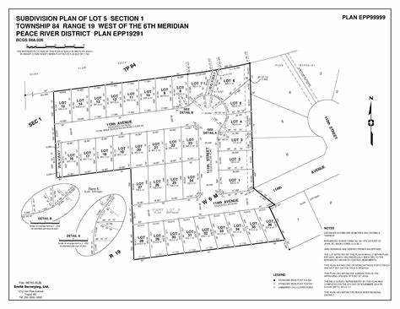
What is a subdivision?
RMA and title creation
Assumption of resource consent (s 11)
Provision of legal and physical access (s 106)
Implementing a survey plan?
Obtaining sales?

Slide 5
The question of scale

Slide 6
What is (or is not) a subdivision?
Big River Paradise v Congreve
Covenant restricted “subdivision”
Developer implemented 35 year leases
Court effectively said a restriction on “subdivision” doesn’t mean “subdivision of land as defined in section 218 of the RMA”, and can be broader
Re McKay
Conversion of cross lease to fee simple
Deposit of survey plan means it is a “subdivision”
But consent authority can’t impose too many conditions

Slide 7
What is (or is not) a subdivision?
Clearspan
“Cross-encumbrance” arrangement
Ownership of undivided share of land plus encumbrance for exclusive use area
Not a “subdivision of land” under section 218 RMA
Cross leases (generally)
Once not a subdivision, now are
Division of land under section 339 PLA

Slide 8
What type to choose?
Fee Simple
Cross Lease
Unit Titles
Vs
Fee Simple with Land Covenants
Fee Simple with Residents Society (and Land Covenants)
Body Corporate with Rules
Body Corporate with Rules and Covenants

Slide 9
What type to choose?
Fee Simple
Cross Lease
Unit Titles
Vs
Fee Simple with Land Covenants
Fee Simple with Land Covenants and Design Guidelines
Fee Simple with Residents Society (and Covenants)
Fee Simple with Easements with Unincorporated Association
Body Corporate with Rules
Body Corporate with Rules and Covenants
Cross Lease conversion to Fee Simple

Slide 10
What type to choose?
Planning frameworks
Practicality
Governance Issues
Enforceability
Marketability

Slide 11
What type to choose?
Planning frameworks
District Plan restrictions on how many lots may be served by a right of way.
That 1 – 6 lots may be served by a private way of at least 3.6m.
That 7-9 lots in a fee simple subdivision may be served by a private way of 6m.
That 10-20 lots in a fee simple subdivision may be served by an access of 16m vested as road.
That 7—20 lots in a unit title subdivision may be served by a private way of 6m.
That a maximum of 20 lots may be served by a private way, after which road must be vested
(see Hamilton City Council District Plan, chapter 23.7.3).
Cross leases non-complying in Hamilton

Slide 12
What type to choose?
Planning frameworks
Should planning determine tenure?
How many lots may be served by a right of way, with or without a governance structure
Cross leases as non-complying
Are these “effects” or preference?

Slide 13
What type to choose?
Practicality
Unit titles (initially) driven by practicality
Freely transferable
No complex easements (incidental rights)
Greater sense of individual ownership than with company title
Extensive compliance

Slide 14
What type to choose
Apartments
Townhouses
Unit | Unit | Unit
Unit | Unit | Unit
Unit | Unit | Unit
Unit | Unit | Unit
Townhouse | Townhouse | Townhouse

Slide 15
What type to choose?
Practicality
Unit titles – must construct to get titles
Implications for financing
Fee simple – can separate land from build
Superlots

Slide 16
What type to choose?
Governance (collective decision making)
Example: limits of standard implied easement terms for multiple owners (above about 6)
Body corporate vs incorporated society (vs company or unincorporated association)
Tenure and governance (UTA means body corporate)

Slide 17
What type to choose?
Body corporate pros
Incorporated society pros
Parameters defined by statute
Useful remedial powers
Eg remedial scheme, administrator
Tenancy Tribunal jurisdiction
Useful case law
Consumer protection
Eg levying, disclosure, minority relief
No minimum number of members
More flexible than body corporate
Eg members’ rights
Levying
remedial obligations
rule breaches
Further reform unlikely

Slide 18
What type to choose?
Body corporate cons
Incorporated society cons
Overly prescriptive (levying, insurance)
Uncertainty in place
Case law often strange
No penalty provisions
Tribunal jurisdiction can be slow/cumbersome
Often assumes a single building
Governance depends entirely on constitution/rules
Specific rules necessary
Minimum 15 members (10 soon)
Remedial provisions less helpful
No Tribunal (DC or HC)
New statute means uncertainty
Less consumer protection

Slide 19
What type to choose?
Hybrid options, eg different body corporates linked by membership of incorporated society (Newhaven)

Slide 20
What type to choose?
Enforceability
Body corporate
Tenancy Tribunal, District Court, High Court (and sometimes straight to HC)
Amendment Act: MBIE infringement notices, pecuniary penalty orders
Incorporated society
District Court, High Court
New Act: Dispute resolution and complaints procedures in constitution

Slide 21
What type to choose?
Enforceability
Incorporated Society
Common to have a land covenant requiring membership of society
Drafting of covenant – society vs company (Lakes Resort)
Encumbrance vs covenant in gross
Body corporate – incidental rights
PLA section 298 – implied rights over JOAL

Slide 22
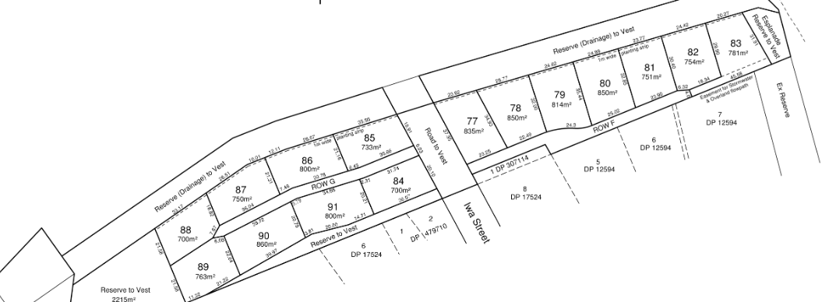
What type to choose?
Enforceability
PLA section 298 – implied rights over JOAL
Vs panhandles

Slide 23
What type to choose?
Enforceability
Easements and covenants and Vesting Clauses

Slide 24
What type to choose?
Marketability
Reservations about unit titles
Levies, managers, neighbours, leaky buildings, disclosure
Reservations about:
Cross leases
Company title
Leasehold

Slide 25
What type to choose?
Marketability
Reservations about governance?

Slide 26
Questions

