Slide 1
How do you make it fit?
Michelle Fletcher 2023

Slide 2
How do you make it fit?
Michelle Fletcher 2023
Notes:
Tena koutou. My name is Michelle Fletcher I'm a licenced cadastral surveyor working for Woods in Christchurch . I gained my registration as a surveyor in 1999 and have worked largely with cadastral information since then. One of the things I really like about cadastral surveying is starting out with a whole collection of information that doesn’t fit well together and putting it together in a format that has improved the cadastral network for those that follow me. I also love the idea of being part of the historical record of New Zealand, I think that's pretty cool. My claim to fame is that I was the first to lodge and have e-plan approved in New Zealand, And the first e-surveyor to have a requisition, but moving right along. I’ve also been involved representing surveyors as a member of the STEP working group since 2017.
The project case study that I'm here to talk to you today is two lot subdivision at 39 Gracefield Avenue in Christchurch. This case study is presenting a technique we commonly use to solve tricky cadastral problems.

Slide 3
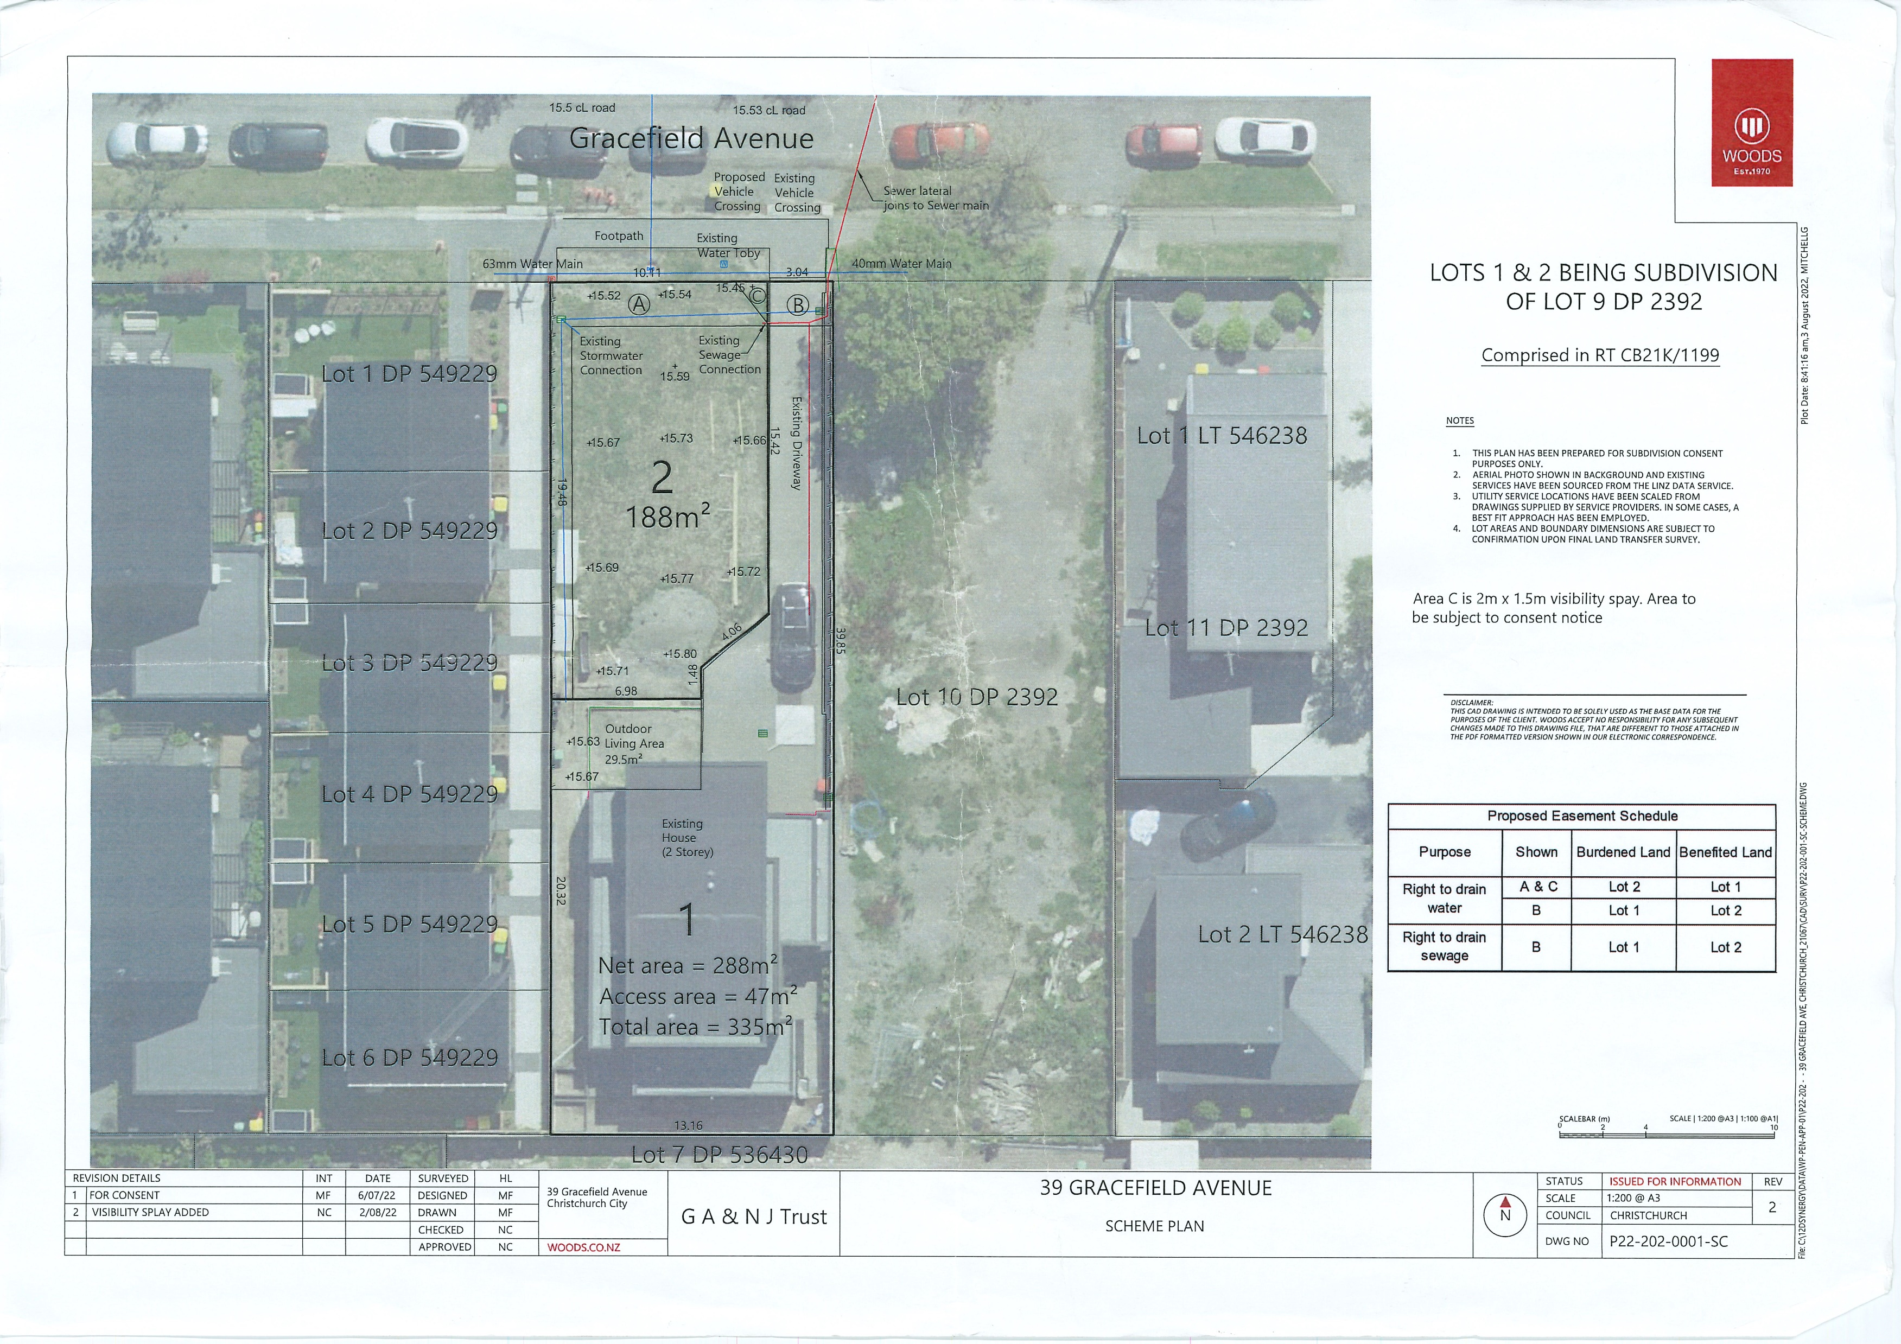
Scheme plan
Notes:
Looking at this scheme plan up on screen at the moment you can see that it’s a pretty simple job. On one side there is really recent subdivision, but our lot and the neighbouring lot are much older and haven't been defined for a long time. A subdivision has recently been carried out on the section at the rear abutting it. My first assessment of this project is that it would be simple because of the definition of the recent subdivision and we just have to fit our work with the underlying information and with what that plan defines. Hopefully that recent plan established quite a few nice control marks out on Gracefield Ave. and we'll be able to tie our survey work into it. But optimistic beginnings don't necessarily pan out do they and the other complication of course is the impact of the earthquakes which is something that we consider always in Christchurch.

Slide 4
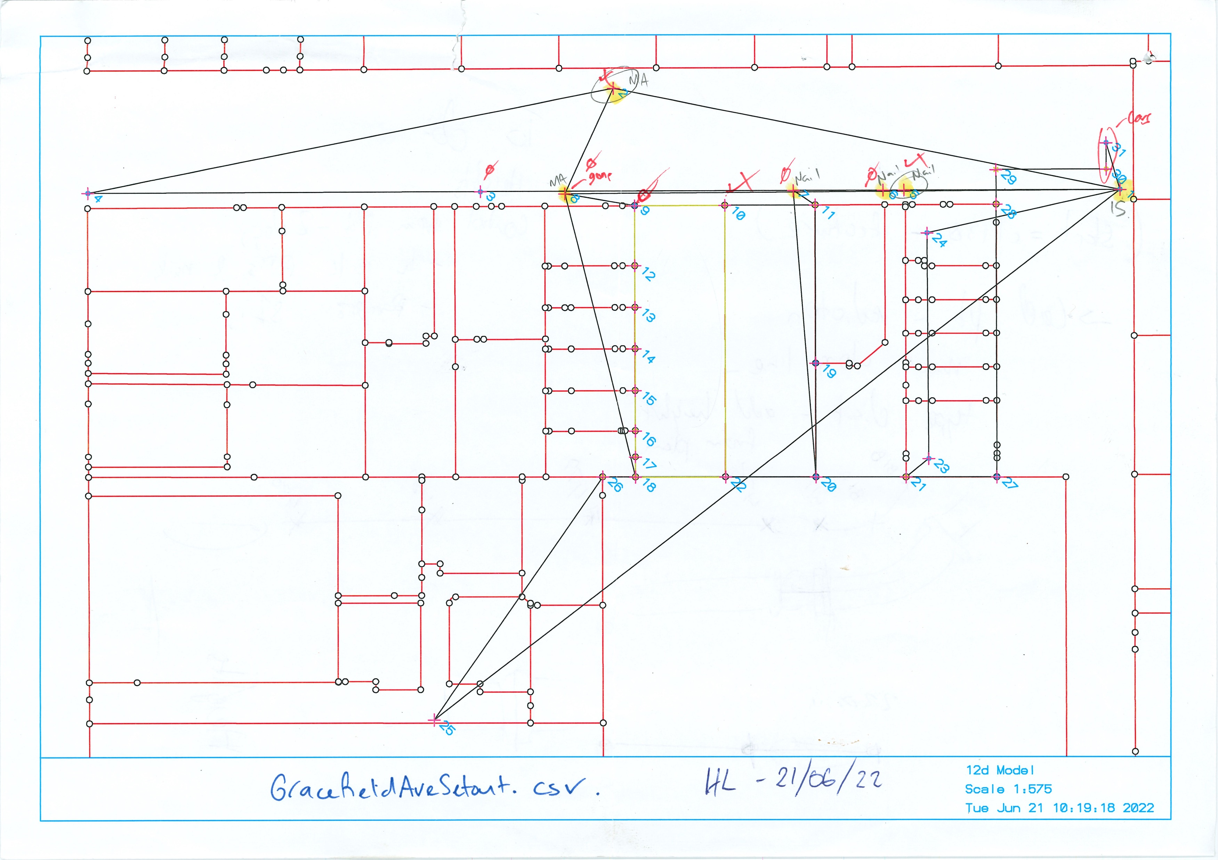
Calculation sheet
Notes:
Our first step is to do some initial calculations to see what information we actually have. And then we sent a man out the field to search for as many marks as he can find and measure their position with GPS. The calculation sheet shown up on the screen illustrates some of the under lying adoptions that have been used to determine the definition of the site. You can see there are some quite direct adoptions on the West side through the recent plan and some slightly more complicated connections to determine the east side and rear. I was expecting that due to the recent nature of many of these survey marks that we'd be able to find them all but as the case would be Hamish came back from the field and said he couldn't find many of these marks as they had been destroyed by recent construction works of a subdivision on the adjoining lot. Out of all the marks that I sent Hamish to go for that day he only found two, it was a bit disappointing. So we had to come up with another strategy.

Slide 5
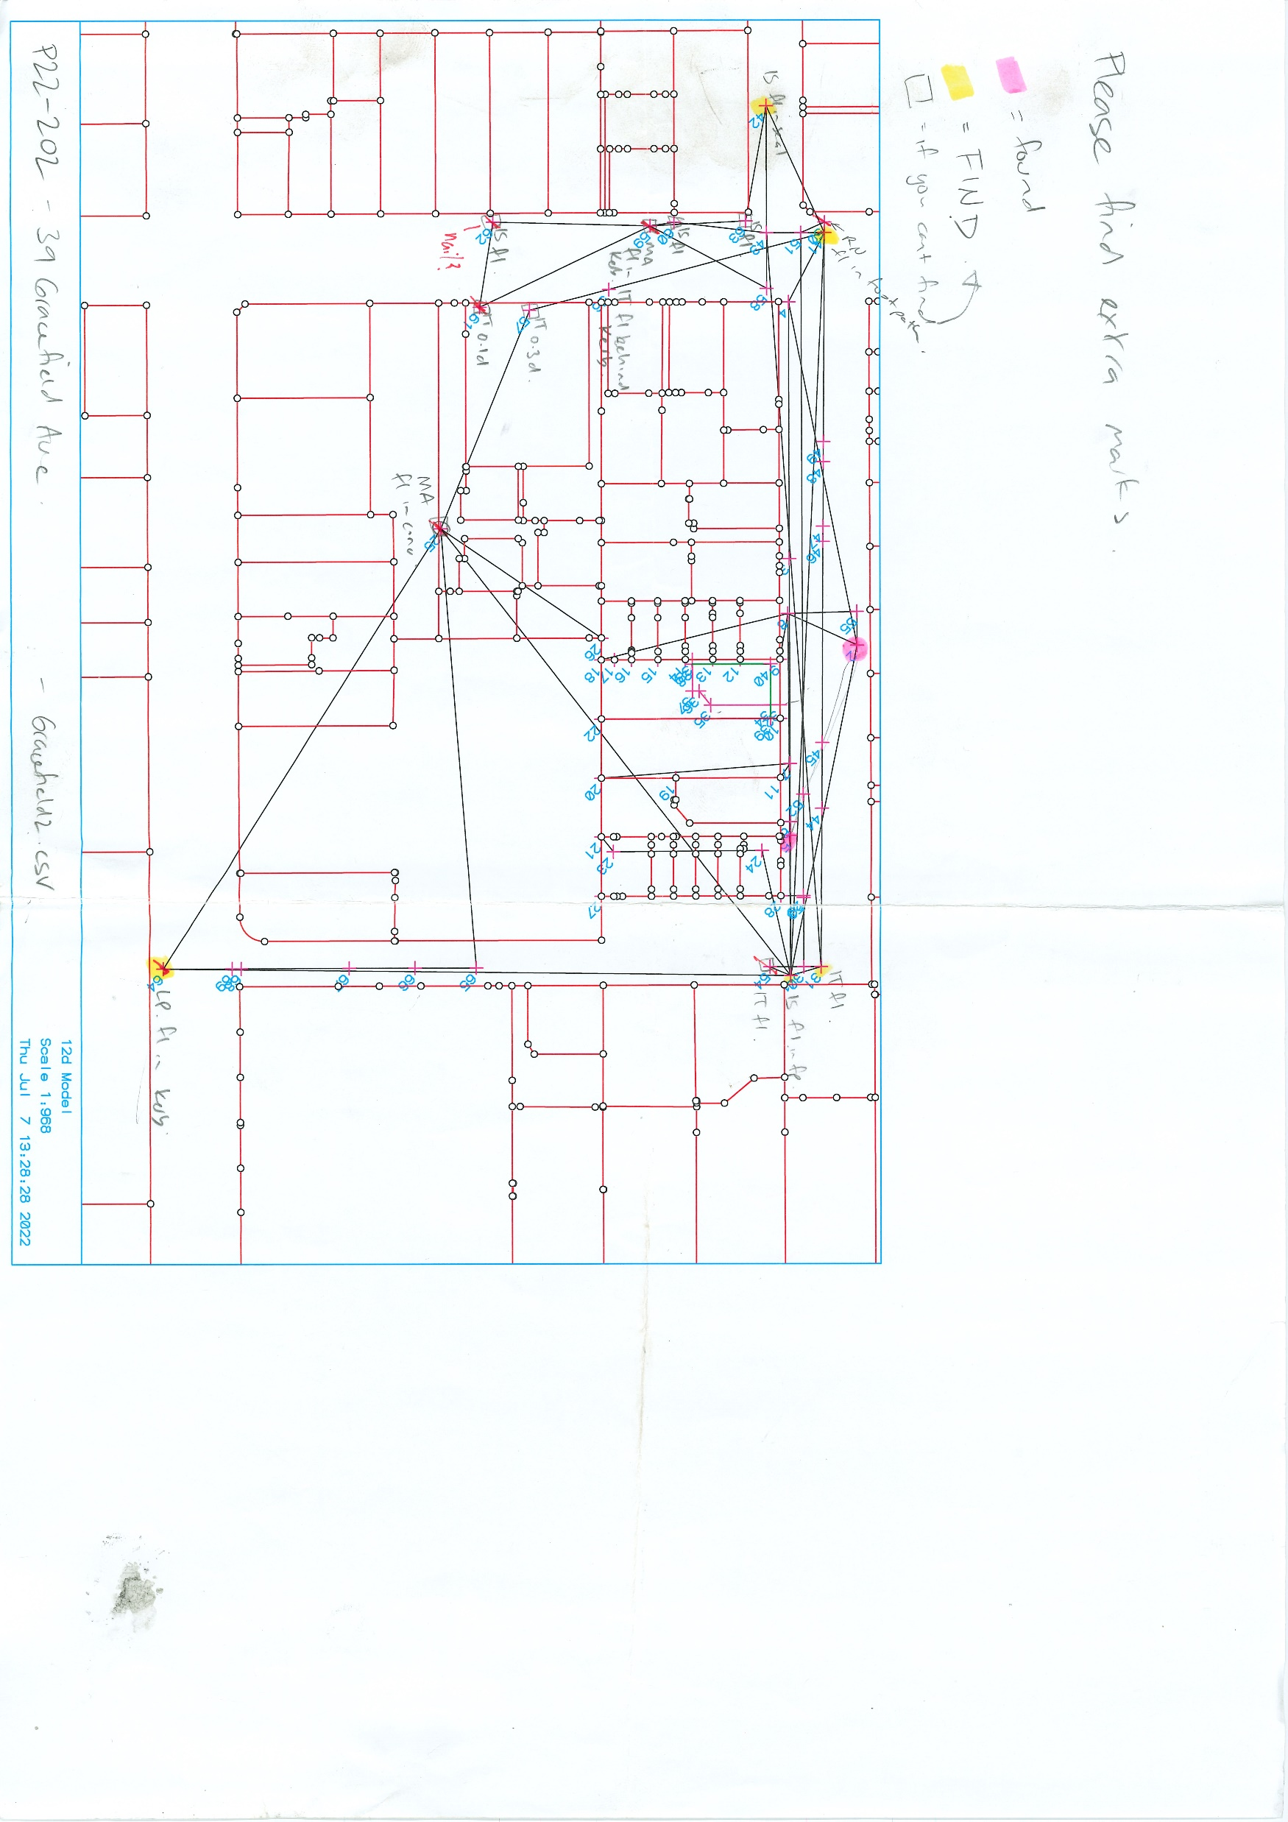
Calculation sheet # 2
Notes:
As you can see on the screen now a different calculation sheet that I've added considerably more traverse information from surrounding streets. With Hamish finding so few marks it was time to get desperate and to have plenty of redundancy so that when we were searching for marks they would at least find something. Fortunately, it was a much better day for Hamish in the field and he managed to find about seven of the marks that I asked him to look for. Unfortunately the data had been set up in a somewhat clumsy manner and we certainly couldn't just upload the traverse spreadsheet directly into land online the way it was. At this point one of our graduates, Chris, was asked to peg the boundaries which he did in terms of the closest mark. To complicate things even further the neighbouring subdivision during this time had also been lodged and approved as to survey so we had to take that into account in our calculations.

Slide 6
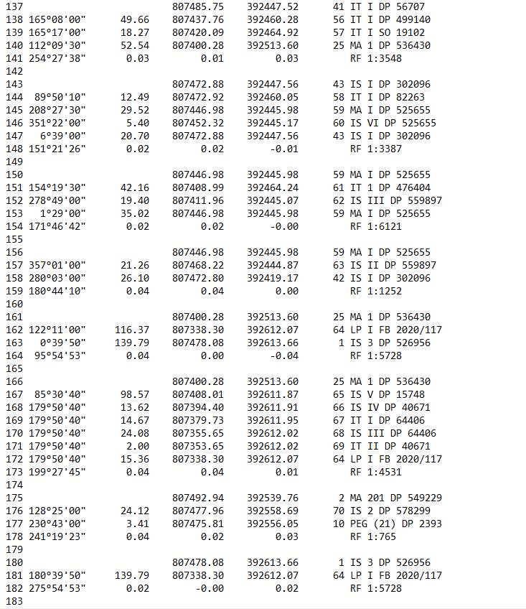
Traverse Spreadsheet
Notes:
At this point Chris who had been out and done the pegging was asked to do the calculations to tidy the plan up and get it into landonline ready for 223 certification. Chris was looking quite closely at the information comparing what the position that the marks had been measured to what we've calculated in the traverse and discovered the everything had poor miss closes, not big miss closes just little ones that were not as good as would be normally expected. This is a not uncommon problem when you're looking at GPS data and earthquake movements and total station observations. The miss closes are partly due I think to all the different styles of equipment and various accuracy tolerances and the earthquakes over the years but it can be managed.

Slide 7
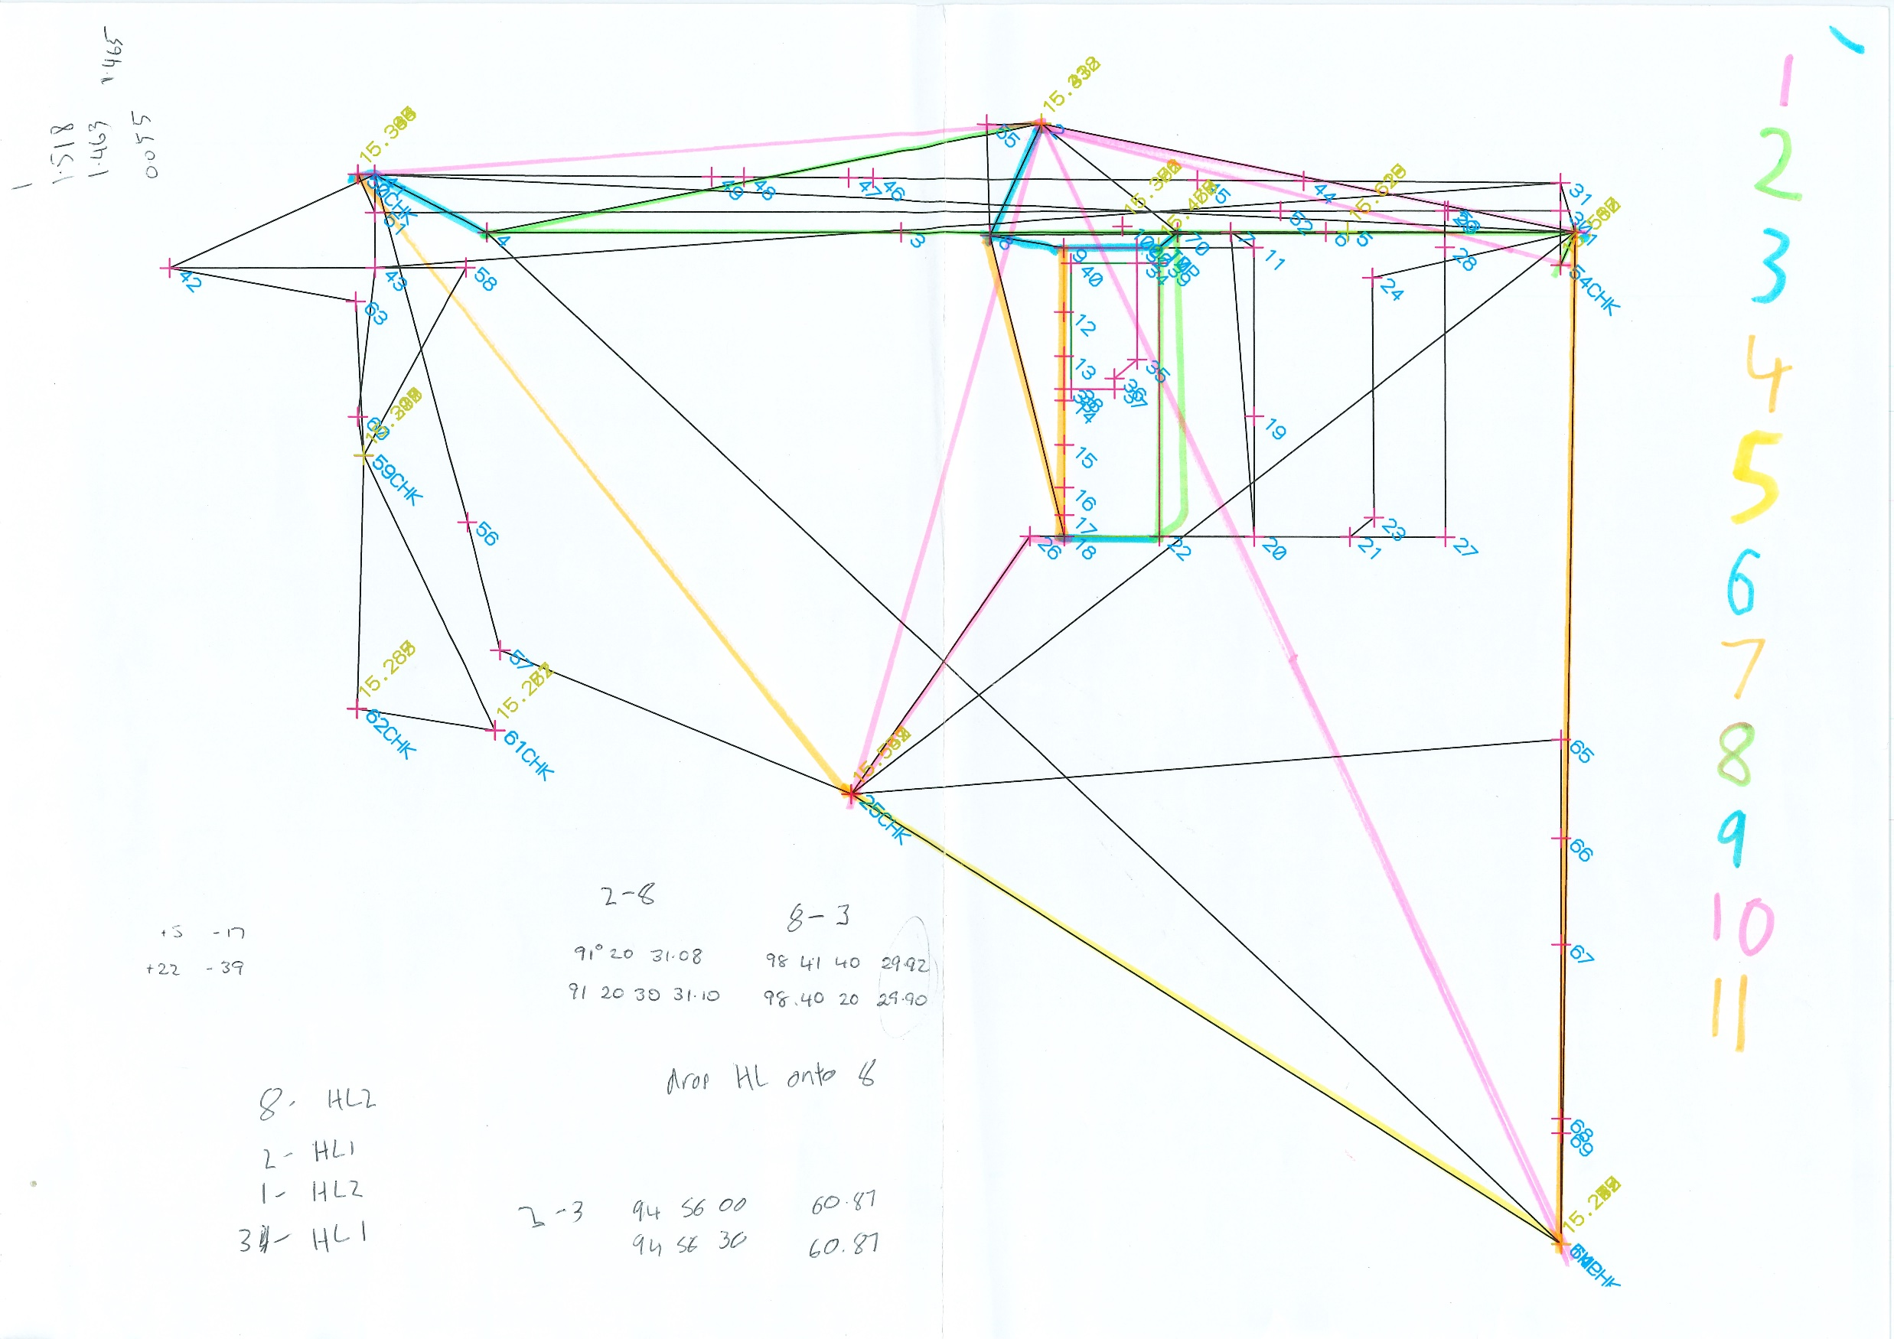
Calculation sheet
Notes:
This is where the question came up; how do we make it fit? So in cases like this where things don't quite fit we've developed a technique that helps smooth out these miscloses. The technique is very simple, we do this, we hold a point close to our site as the origin point, in this case it's #2, up the top. From this origin point we enter into a new traverse spreadsheet a radiation block that shows the vectors to all the marks that we found, in pink. We check that our observations fit with any other recent observations. And then we can trace off the traverse that we've already created to populate the new traverse spreadsheet using the radiation points that we observed. Using the radiation block has the effect of tying down the positions of the found marks and any errors are adjusted between them from the underlying work. In this example the next step was to establish the road alignments using underlying adoptions, it's coloured green and then the blue adoptions for the road side. Next was to use adoptions to define the west boundary. We followed this with checks between the relationships with existing marks. The miscloses on these particular blocks in the traverse spreadsheet were not that good or that bad but complied with the rules and solved the how do we make it fit problem. The final block defined the east side using the information from new subdivision and closed the lot. A check adoption to confirm that we hadn’t encroached into the parcel the south of the lot was also added. Though I did notice that some other subdivisions in this area had bothered to do the same. All the other ties needed to define the new lots were added at this point

Slide 8
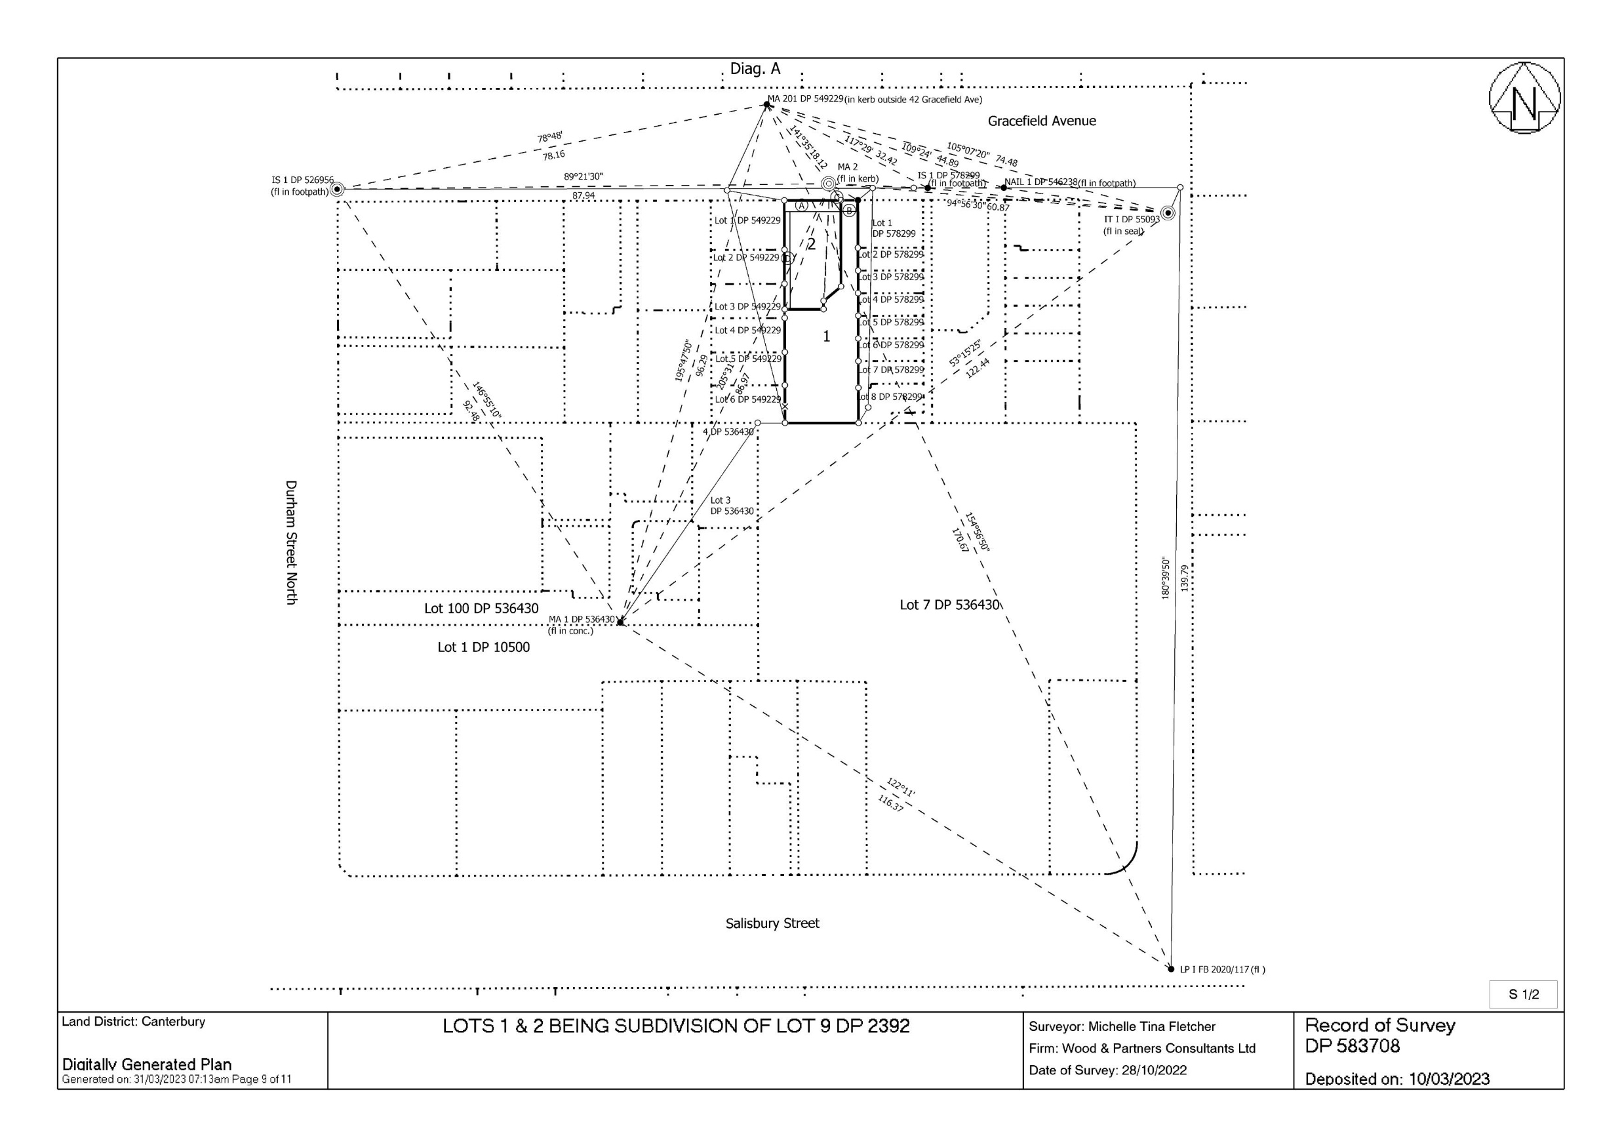
DP 583708 S1 and original calculations.
Notes:
As you can see on the sheet one of DP. 583708 that the plan is quite a lot simpler than the original calculations. I think this is really important to maintain clarity within the cadastral survey network, if we don't trim down our data sets to the important things there is just going to be so much clutter.

Slide 9
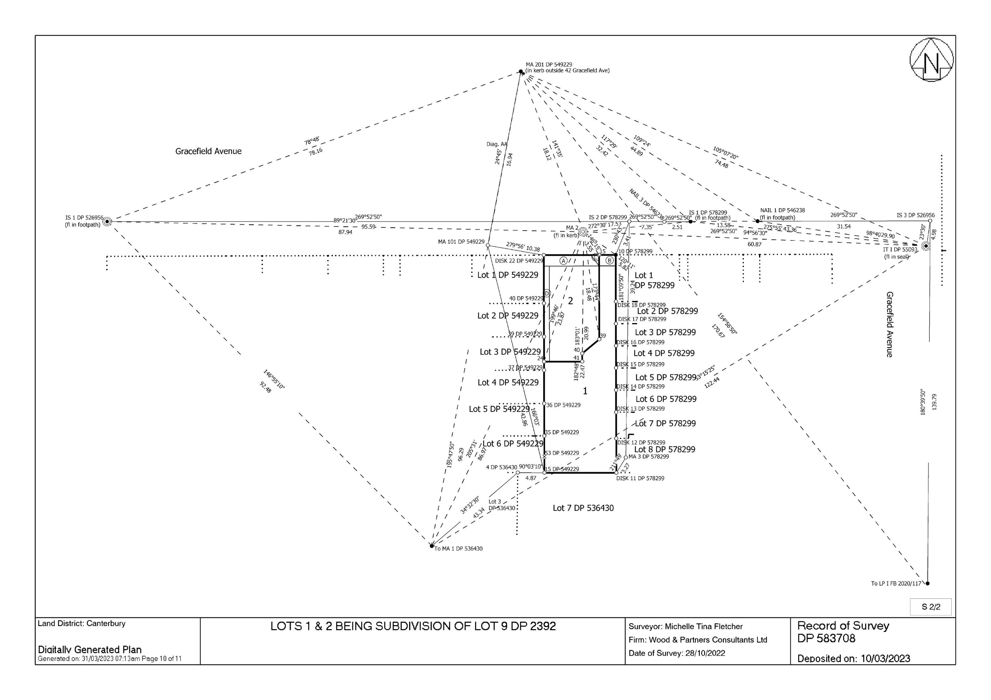
DP 583708 S2
Notes:
Minimising the clutter in your plans is going to be even more important in the coming few years as survey data plan sets are phased out and a new online version is phased in. You can see on this sheet two of this plan that I've distorted things to make them clearer this may not be possible in the future so consideration as to how your data looks before you add it online is going to be really important and a good habit to get into.
So that’s how we made it fit , how do you make it fit? Nga mihi.

