Slide 1
The Impact of Artificial Intelligence on the Surveying and Spatial Industry
Sam Thompson

Slide 3
The Impact of Artificial Intelligence on the Surveying and Spatial Industry
Sam Thompson

Slide 4
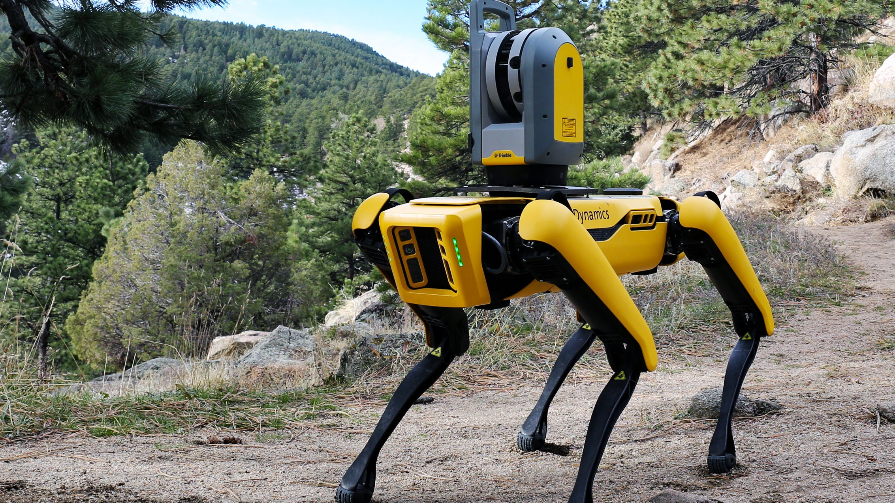

Slide 5
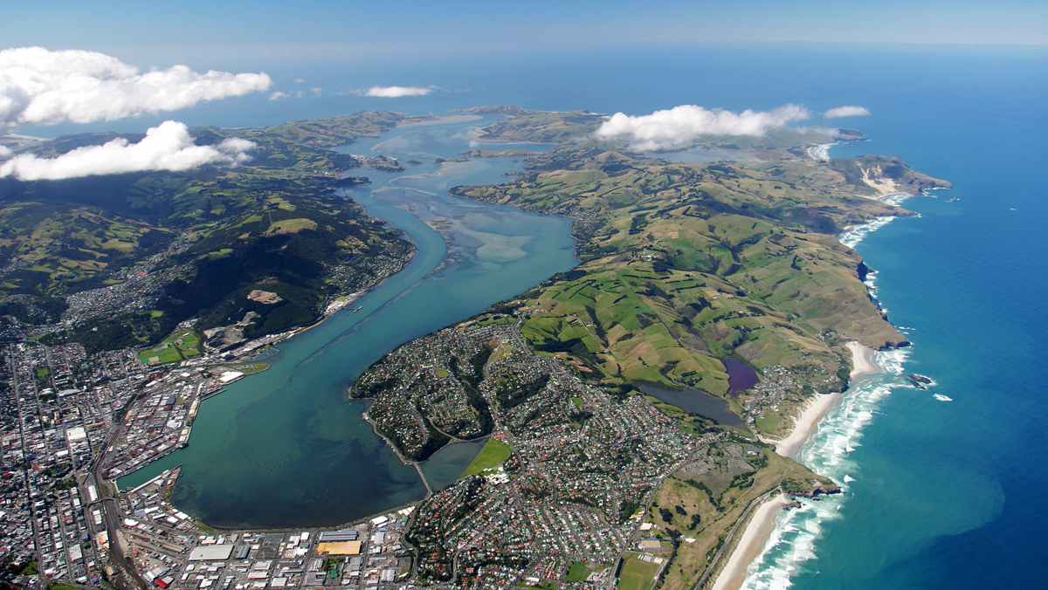
Ka Mua, Ka Muri
Walking backwards into the future

Slide 6
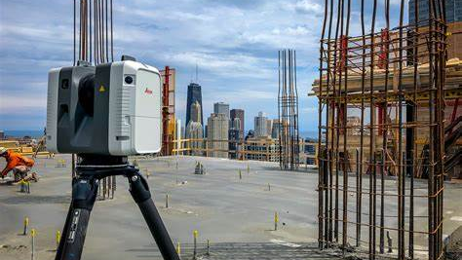

Slide 8
Ka Mua, Ka Muri
Walking backwards into the future

