Slide 1
A Chronical of Human Cohabitation
How we have lived together over time
Riki Cambridge – Licenced Cadastral Surveyor

Slide 2
Timeline of human existence
Notes:
Im going to take you on a journey through the timeline of human existence.
The agricultural revolution happened 5% of the age of our species ago. So that would be about here (middle of Empires)
The First homo sapien remains date back to 300 000 years ago.
Agricultural revolution 12-15 000 years ago.
First empires 5000BC- 500AD so 7000-1500 years ago.
Feudal times 1500- 250 years ago.
Industrial revolution 250-100 years ago.
Suburbia post WWII 70 years ago.
So as far as our DNA is concerned the agricultural revolution was about a month ago, Rome was peaking a week ago, the industrial revolution was a day or two ago, and the car was invented when we all sat down to listen to the first speaker this morning.

Slide 3
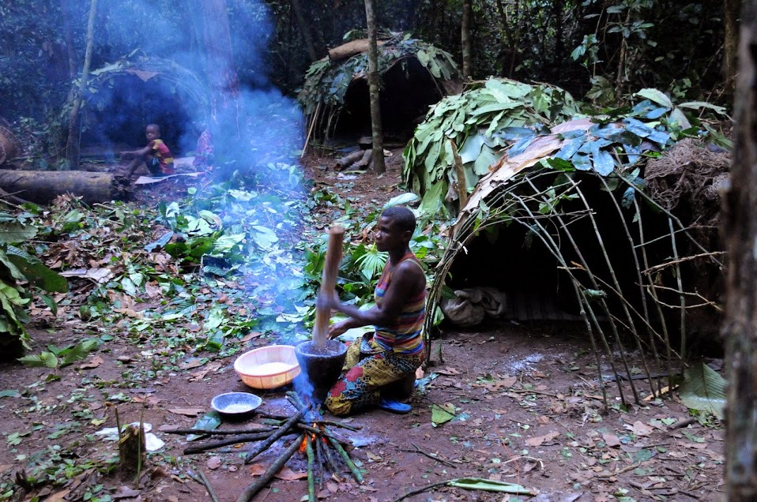
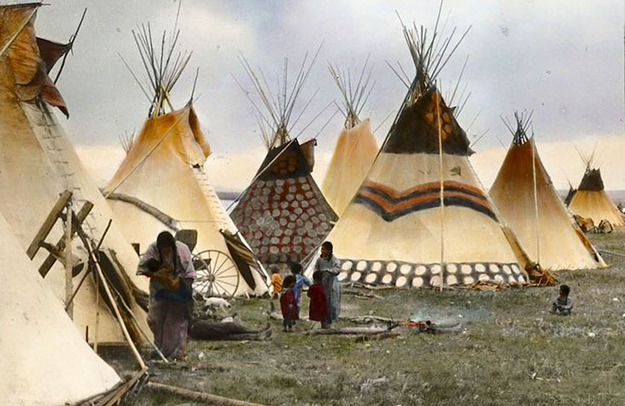
The early days of humans
By JMGRACIA100 - Own work, Source: Wikipedia (2023)
Source: static.boredpanda.com/blog/ (2023)
The earliest homo sapiens were physically and mentally the same as we are now.
We are them.
300,000 years ago
Notes:
“The vast majority of people lived in small bands numbering several dozen or at most several hundred individuals.” (Sapiens, 2011, Yuval Noah Harari)
“Members of each band knew each other very intimately, and were surrounded throughout their lives by friends and relatives. Loneliness and privacy were rare” (Sapiens, 2011, Yuval Noah Harari)
“Most Sapiens bands lived on the road, roaming from place to place in search of food.” (Sapiens, 2011, Yuval Noah Harari)
Importantly for housing, they were on the move often, and their shelter would need to be portable.
Also, this was prior to the domestication of animals, so there wouldn’t have been any horses or oxen to pull a cart. Light and simple was best.
Being hunter gatherers, these people were highly in tune with their natural surroundings.
Everything about the way they lived was focussed around living as part of a strong group.
“In addition to murder and theft – one of the most commonly punished infractions was “failure to share.”” (Tribe, 2016, Sebastien Junger)
This advantage of community has been imprinted in our DNA, “When a person does something for another person…. They are rewarded not only by group approval but also by an increase of dopamine and other pleasurable hormones in their blood. Group cooperation triggers higher levels of oxytocin,…,which promotes everything from breastfeeding in women to higher levels of trust and group bonding in men.” (Tribe, 2016, Sebastien Junger)
Charles Darwin in the Descent of Man commented on the strength of community.“Those communities which included the greatest number of the most sympathetic members would flourish best, and rear the greatest number of offspring.”

Slide 4
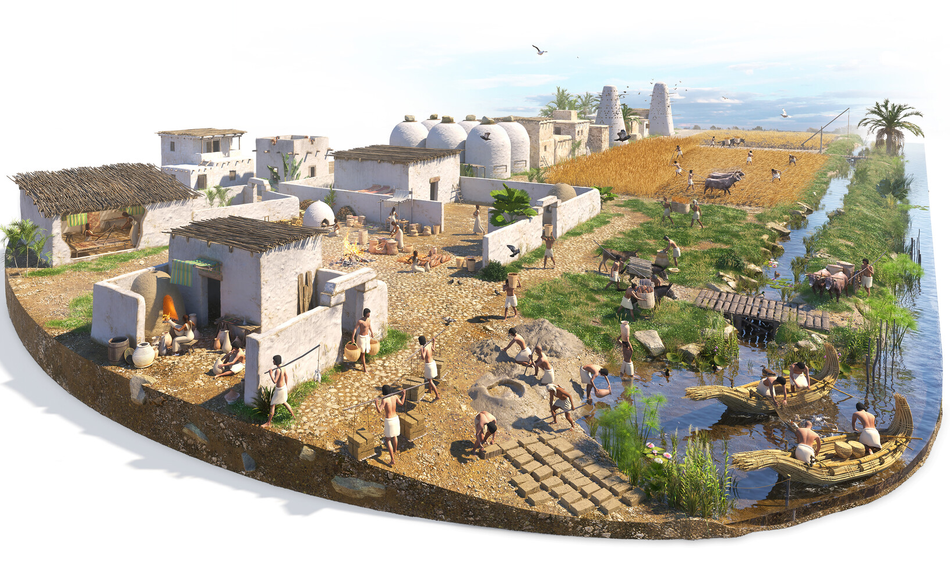
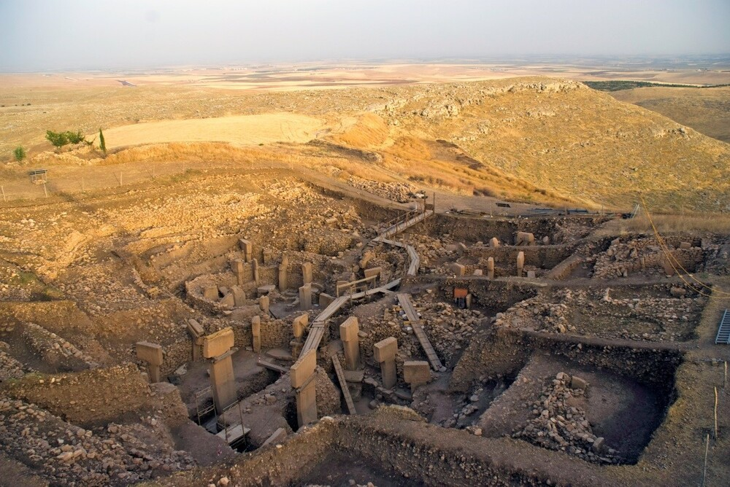
Agricultural revolution
Source: cdnb.artstation.com (2023)
Source: UNESCO (2023)
The first time people built houses and lived in one spot for any length of time.
12-15,000 years ago
Notes:
This long period of living as hunter gatherers was broken by the proliferation for farming that was the agricultural revolution.
Farming tied people to one spot and created excesses that were able to sustain more people.
People living in one place are able to accumulate more things. Having more possessions when you die, means a greater focus on who to pass the accumulated wealth on to. This is thought to have created a greater focus on the nuclear family and hereditary lines, rather than a broader group.
Gobekli Tepe in modern day Turkey is the oldest known permanent human settlement(c10000 yrs). Although, there is evidence that it was frequented seasonally by larger numbers depending on the availability of food.

Slide 5
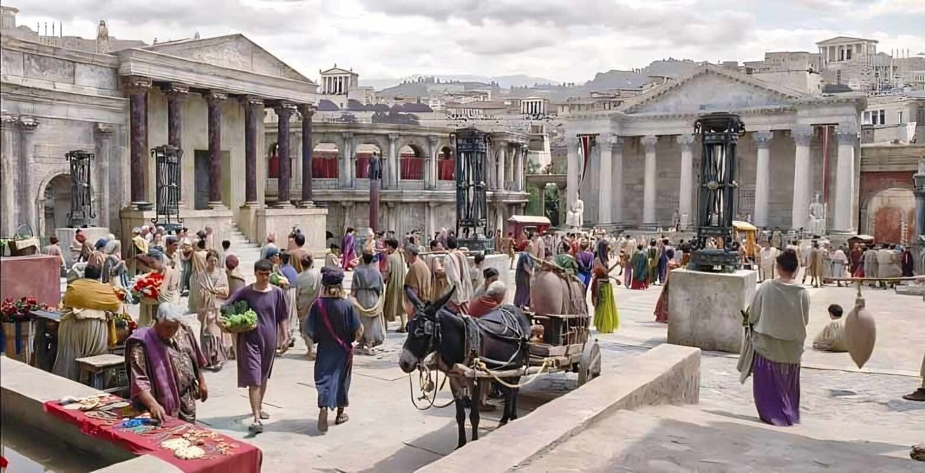
The early empires
Source: Malevus (2023)
The first evidence of complex social structures
7,000 years ago
Notes:
The excesses of agriculture enabled rulers to pool more and more wealth/people together and they went to war with the world.
Starting with the Sumarians in the middle east, then the Egyptians. Followed by the Romans that we are more familiar with.
These empires rules over vast distances with many different cultures and customs. Intricate laws and regulation were required to keep people in line with the will of rulers.
Along with the size of the empires, the cities grew as well. This diagram is typical of a Roman town house. Multi story and mixed use.
It was during this period that the first evidence of different social classes emerges.

Slide 6
Fudalism
Feudalism
Source: Thinglink (2023)
1,500 years ago
Notes:
Following the fall of the Roman empire, power disbursed and became far more localised.
The well structured society based on land ownership and fealty to over lords, was continued and refined from the early empires. Land ownership and power was largely passed down family lines, with very little scope for social mobility.
The peasants lives would have been controlled by the local lord, and they would not have been able to move about freely to live elsewhere.
These people would have spent their entire lives in their local village, only interacting with the same restricted group of people, much like their forbearers.

Slide 7
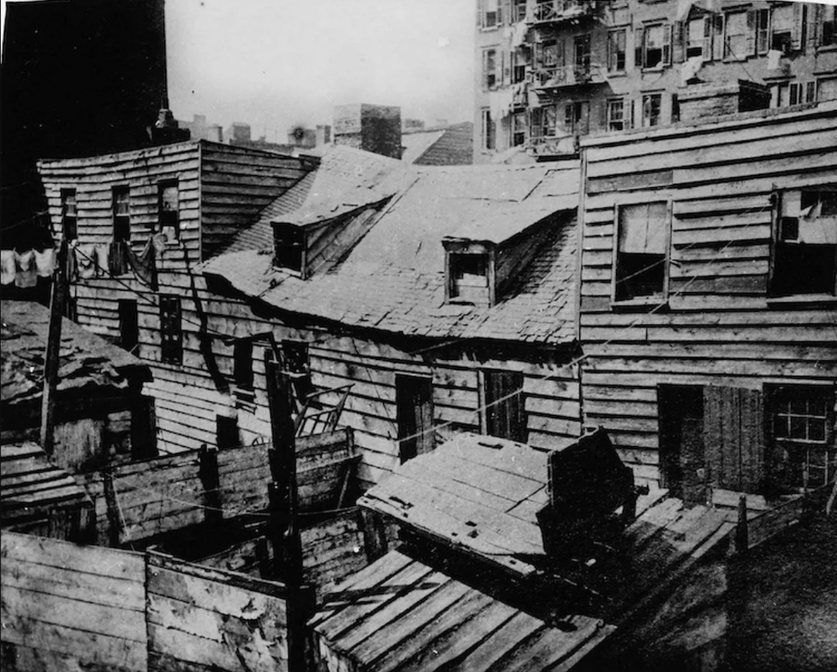
Industrial Revolution
Source: prod.mirror.co.uk (2023)
Source: Tumblr (2023(
Mass migration from the countryside to the centres of industry
250 years ago
Notes:
The industrial revolution was the next most important change in how we lived, since the agricultural revolution thousands of years prior.
Technological advances in manufacturing and agriculture created a mass exodus of peasant farmers from the fields, to the factories and mines. This caused a massive increase in the population of cities.
The social classes very much followed the feudal example. The main difference being the land owning lords were joined by the merchant class, who became very rich from the companies they owned.
The businesses themselves were often larger than the villages that a lot of the early workers would have come from. These businesses all being grouped in the cities made any one individual anonymous and insignificant.
Housing conditions were atrocious, with many families living in single apartments. And all on streets that still had medieval era services.
Now is a good point to reiterate the timeline at the bottom of the page. Large scale urbanisation has only been happening for our very recent past.

Slide 8
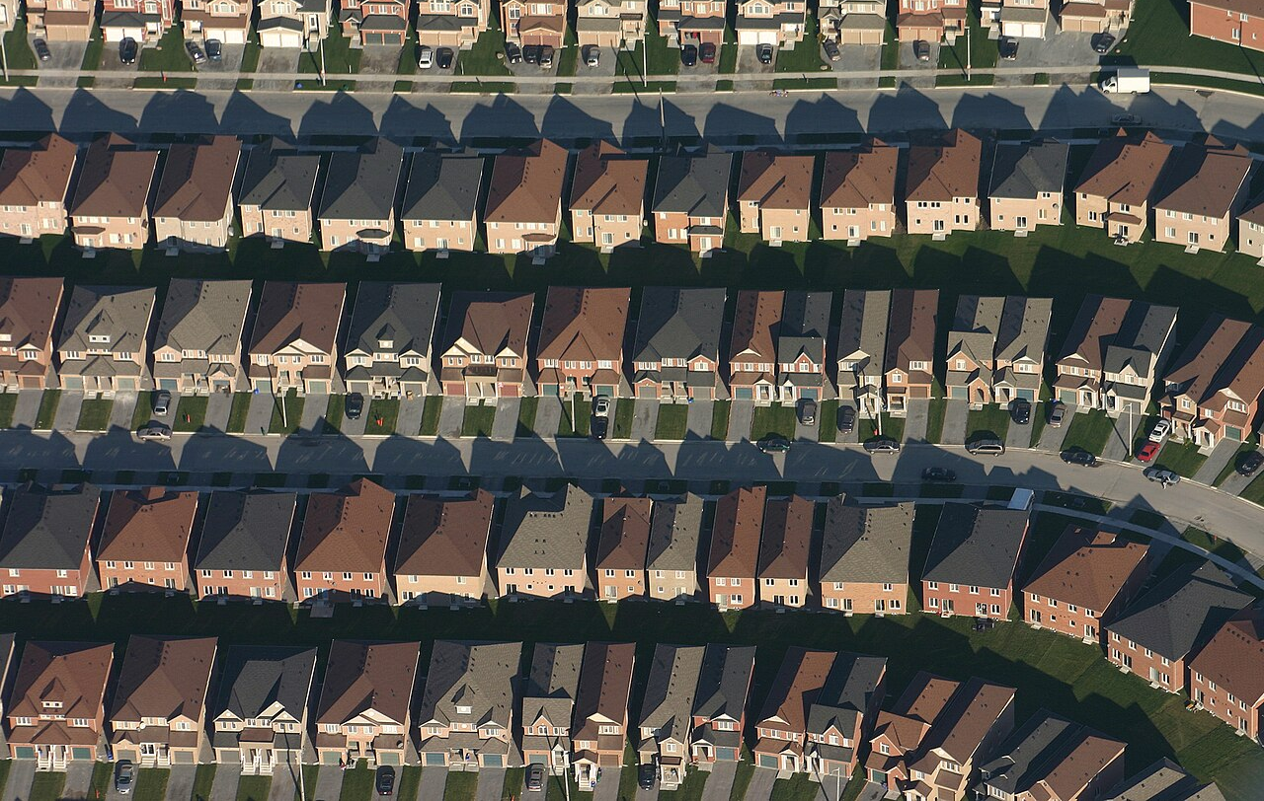
The rise of suburbia and the middle class
Source: Tumbler (2023)
Source: Wikimedia – Markham suburbs (2023)
People with money fleeing the squalor of the inner cities for the freshly created suburbs.
80 years ago
Notes:
The mechanisation of workflows generated so much wealth that it created a new social class, the middle class
These people with their new found wealth wanted to escape the squalor of the industrial inner cities. Their escape in search of their own quarter acre paradise was facilitated by the invention and proliferation of the private car.
This effect was overly pronounced in the rapidly growing colonial cities across the world.
The new neighbourhoods were often structured in such a way that almost all trips from the house required you to drive your car. This has the effect of severely limiting spontaneous interaction with the people living closest to you.

Slide 9
Ills of the world today
Source: National Geographic images (2023)
Source: New Creations Counseling (2023)
Sharing every aspect of your life with close friends who live in the hut next door, that you helped them build, has been replaced by carefully curated content on an electronic device from who knows how far away.
Notes:
In his book Tribe, Sebastian Junger tries to work out why American war vets have such serious issues assimilating back into American society.
He talks about how the soldiers miss the comradery of living and working in a tightknit group through trying circumstances.
This is in contrast to the individualistic, superficial competitive nature of the day to day interactions we have in our lives today.
Anthropologist Sharon Abramowitz was quoted in tribe saying “We are not good to each other. Our tribalism is to an extremely narrow group of people: our children, our spouse, maybe our parents. Our society is alienating, technical, cold, and mystifying. Our fundamental desire as humans is to be close to others, and our society does not allow for that.”
This would suggest that the connections that people are making through their phones and TVs are not stacking up to the ways that our DNA has developed over 10s of thousands of years.
According to Junger, “genetic adaptations take around 25,000 years to appear in humans, so the enormous changes that came with agriculture in the last 10,000 years have hardly begun to affect our gene pool.”

Slide 10
Source: Anxiety.org (2023)
Notes:
There is now a widespread acknowledgement that we are currently experiencing high levels of loneliness across our society. The health effects of loneliness have been compared to smoking 15 cigarettes a day.
At a time that we are supposedly better connected, than any that has preceded us, we are feeling lonelier than ever.
The majority of housing tends to be focused on the nuclear family. Alternatives are often grouped together in separate locations, e.g. retirement villages, and student accommodation.
This grouping of people of particular ages, is pushing the different generations apart.
Also high house prices are requiring parents to work long hours to service large mortgages, meaning more child care and reduced connection with parents.
(When people live further afield they need to drive past more other peoples houses in order to get to the commercial centres to work. These increased commuters with no connection to the neighbourhood create an unsafe environment for kids to play freely in the streets, interacting with other kids their own age. It’s hard to practice and deepen relationships with friends your own age by waving to them from the back seat of an SUV while getting dropped off at school. People of all ages are not getting enough practice at social interactions and making meaningful friendships.)

Slide 11
Recapturing the village in a city
Guide: Japan Guide – Tokyo (2023)
Source: Flickr (2023)
Co housing
Multigenerational housing
Papa Kainga
Semi public/private outdoor spaces
Notes:
So, how do we bring the journey full circle and recapture the village within a current day city.
There is a few examples and initiatives currently in play.

Slide 12
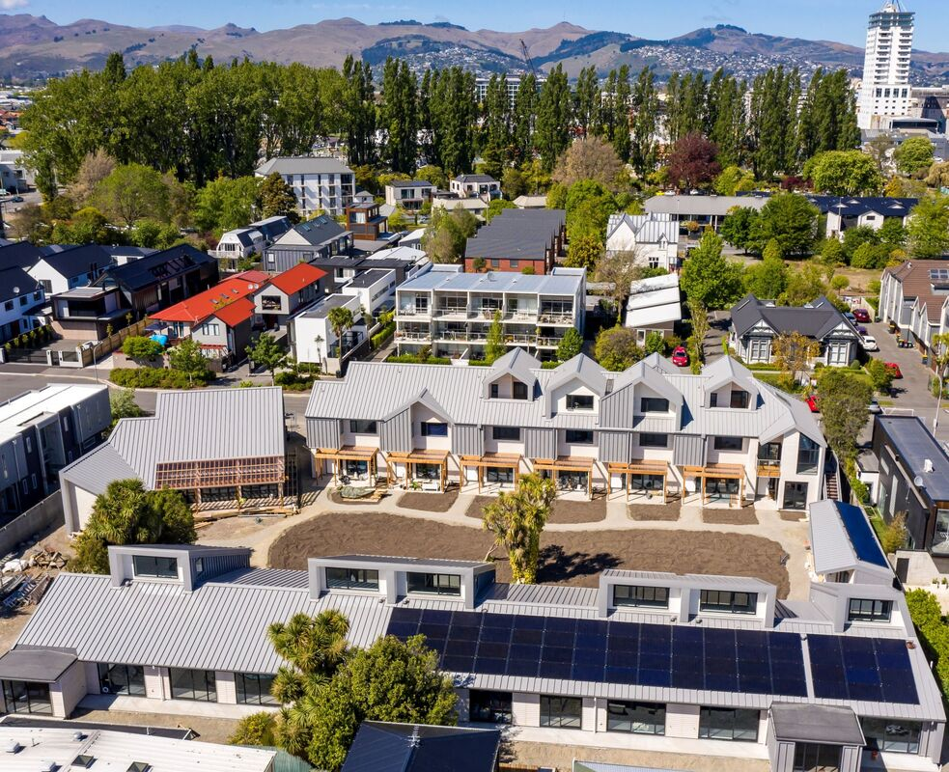
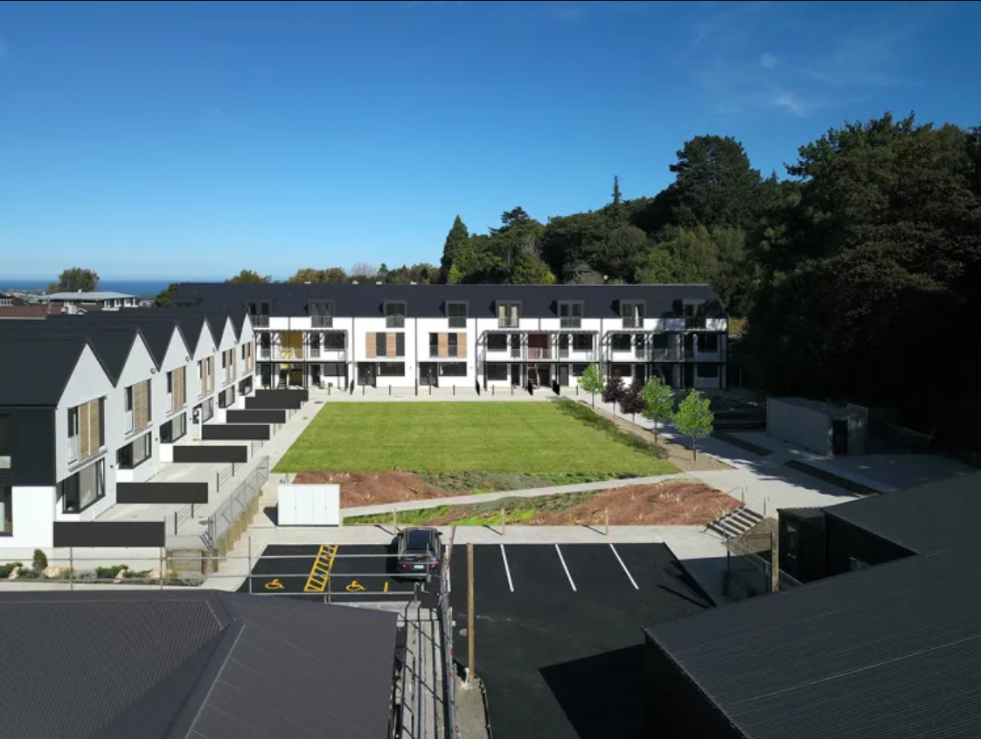
Co housing
Source: Peterborough.nz (2023)
Source: newsroom.co.nz (2023)
A community of private homes clustered around shared space.
Notes:
It’s an intentional community of private, fully self contained homes clustered around shared space. (Wiki)
Generally with a central building that often has a large kitchen and dining space where residents regularly dine together.
It can include shared facilities such as a guest room for residents to book out for friends and family to stay in. Saving on needing a guest room in each house. Also shared utilities such as heating, washing machines. These are all collectively funded and managed.
The intention is to have a diversity of residents with regular interaction between generations.
This creates opportunities for collective child/elderly care arrangements.
There are a number of retroactive co house initiatives, where people have started by removing back fences and creating communal areas. The Peterborough Housing Cooperative on the left here started this way, and was completely reimagined after the earthquakes.

Slide 13
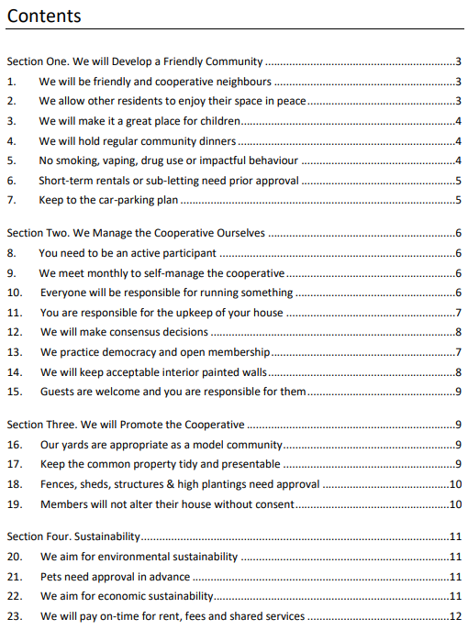
Cohousing issues
Large site required in a suitable place.
Difficult to obtain financing for a collective group with no assets.
Ownership structure. Who owns what? What happens with any rent paid to non profit owners?
Dependent on effective cooperation between all residents.
www.peterborough.nz
Notes:
Large site required in a suitable place.
Difficult to obtain financing for a collective group with no assets.
Ownership structure. Who owns what? What happens with any rent paid to non profit owners?
Dependent on effective cooperation between all residents.

Slide 14
Multigenerational housing
Source: All Gen homes (2023)
Attached housing on one site with options to connect between the two internally, or have them separated with a fire door.
Notes:
Attached housing on one site, with options to connect between the two internally or have them separated with a fire door.
I have split the units in this example with an orange line.
Generally, one larger house suitable for a whole family with some larger living spaces. The second a smaller unit, is self sufficient, but can flow through to the larger unit for social time.
There is flexibility of use over the lifecycle of a family. E.g. Established family with elderly parents attached, or empty nesters with the older kids living next door, empty nesters with the kids young family in the bigger unit next door, or if your family is big enough, spread right across both units. Even live in one unit and rent the second unit to a third party. It is a truly versatile set up.

Slide 15
Multi-generational housing issues
Current lot sizes and shapes not able to accommodate the size of house required.
Because there is a second kitchen it counts as two HUEs and triggers a second set of DCs.
Doesn’t fit with the tried and true business models built around current housing typologies. Easier to continue the status quo.
Fire rating requirements can complicate the building design.
Notes:
Current lot sizes and shapes not able to accommodate the size of house required.
Because there is a second kitchen it counts as two HUEs and triggers a second set of DCs.
Doesn’t fit with the tried and true business models built around current housing typologies. Easier to continue the status quo.
Fire rating requirements can complicate the building design.

Slide 16
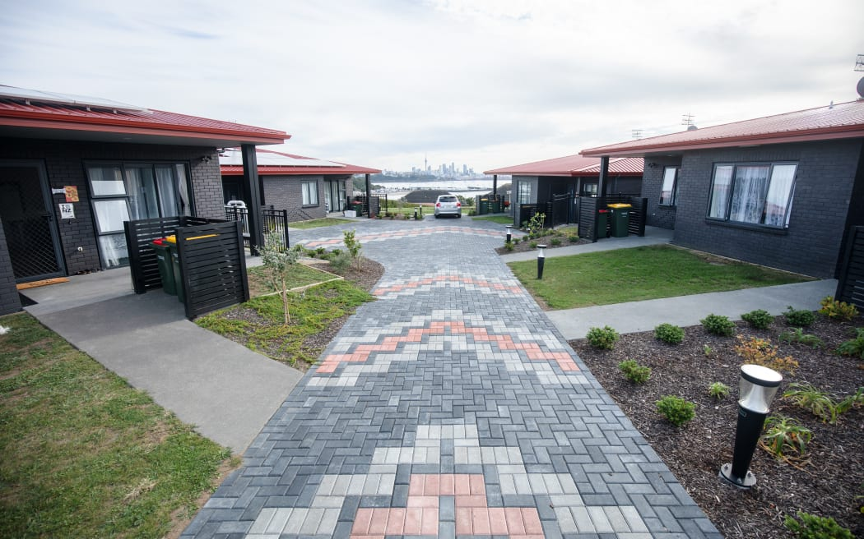
Papa Kainga
Source: Square space (2023).
Source: RNZ (2022).
Māori housing developments, primarily focused on getting Iwi and Hapu members into good housing.
Notes:
Maori housing developments, primarily focused on getting Iwi and Hapu members into good housing.
Various means of funding support enabling people in different stages of life to live together in the one area.
Jade Kake, in the far north is working on plans to build a modern version of a traditional marae. With individual housing surrounding common buildings and a central Marae. This would also include Kohanga Reo to support the community.

Slide 17
Papa Kainga housing issues
Complications with the developments being on Maori land.
Location of the available land.
Needing agreement from the many owners of the land to develop on it.
Banks requiring the buildings to be portable so they could be recovered if the loan was to default. The bank would not be able to claim the land.
Notes:
Complications with the developments being on Maori land.
Location of the available land.
Needing agreement from the many owners of the land to develop on it.
Banks requiring the buildings to be portable so they could be recovered if the loan was to default. The bank would not be able to claim the land.

Slide 18
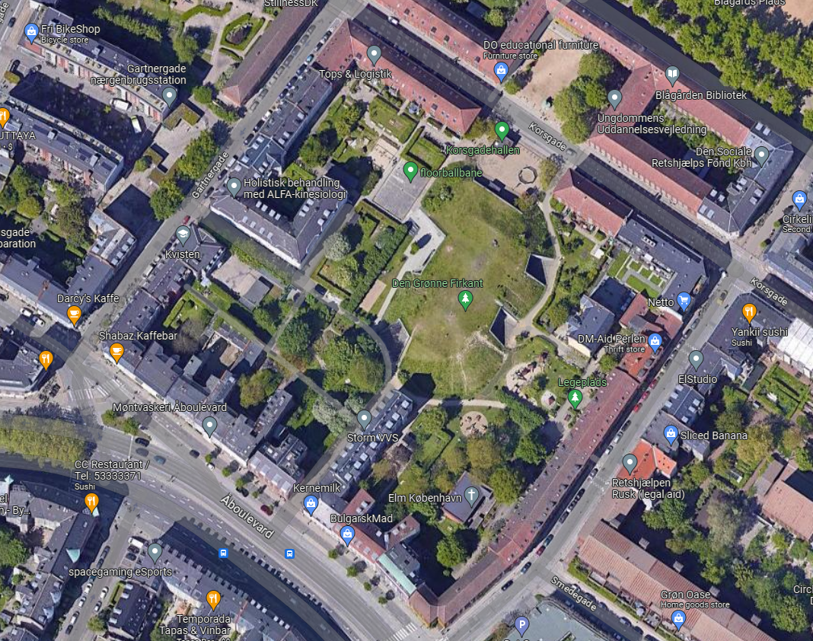
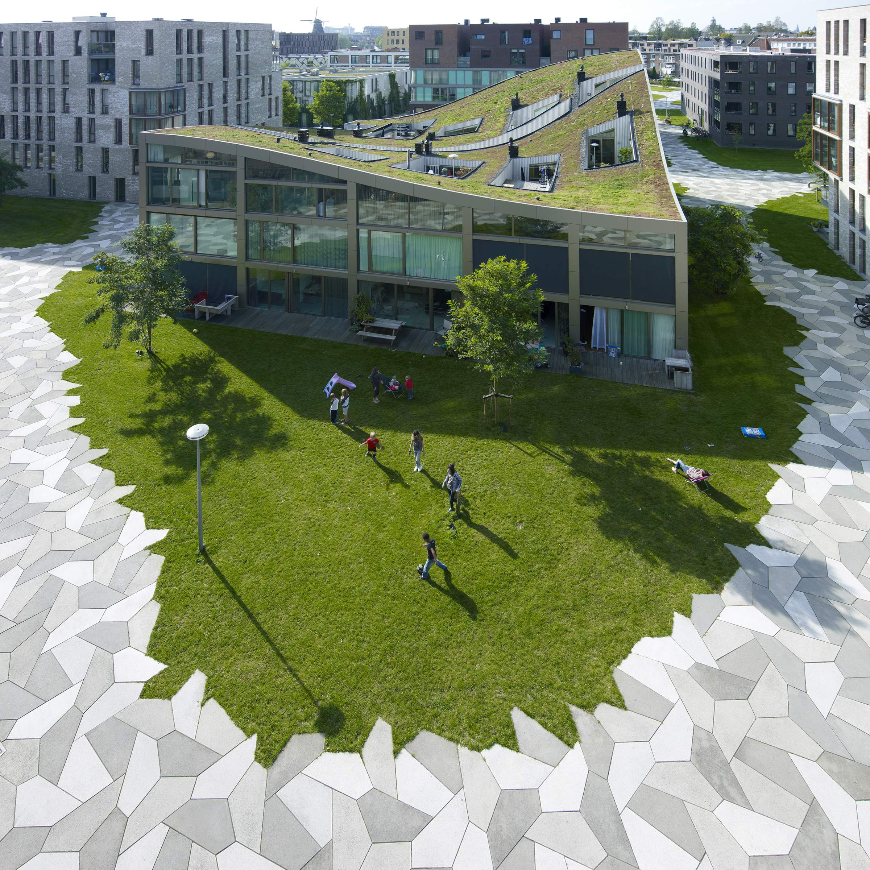
Semi public/private outdoor spaces
Source: Googlemaps (2023)
Source: Landlab - Funenpark (2021).
Source: Landlab - Funenpark (2021).
Three key features to a well utilized public space:
1, A draw to be in the space. 2, A feature to slow or hold you in the space. 3, Permission to be in the space.
Notes:
Our public spaces are vital to cultivating healthy social interactions. There are three key features to any effective public space.
I say semi public/semi private, so that the residents can claim some ownership of the space and make it a desirable place to be. But also public so that others are able to share the area and feel like they are in a safe inviting space. People are what really makes any place interesting, and for them to stay they need to feel invited and safe.
Copenhagen ring apartments, Em and I stayed in an air bnb in this block. It’s open to the public but enclosed by residential buildings, with some mixed use on the outsides. Its within walking distance of the CBD.
Em stayed in some university accommodation at the edge of this complex of apartments in Funen park in Amsterdam. The cool paving invited the public through the area with grassed areas for the residents of each block of apartments to play out doors on.
We are fortunate to live near a wooded gully called the Cracroft caverns. Not many people are aware of it, so we often know the people we bump into when walking the dog. The residents also organise a community bbq once a year, which is a great opportunity to hear some stories about the place from people who had lived there for years.

Slide 19
Semi public/private space issues
Ownership? If a public reserve, it needs to fit with Council vesting and maintenance requirements.
For new developments, it detracts from saleable lot areas.
Dependent on buy in from residents to take ownership of the area.
Time commitment required for maintenance.
Notes:
Ownership? If a public reserve, it needs to fit with Council vesting and maintenance requirements.
For new developments, it detracts from saleable lot areas.
Dependent on buy in from residents to take ownership of the area.
Time commitment required for maintenance.

Slide 20
Conclusion
We can’t afford to design meaningful social interactions out of our lives, it needs to be built into our living environment.
To achieve this, some next steps include:
Gaining buy in to the importance of these principles and systemic change from all players in the land development cycle :
Real estate agents and “the market”,
the financial sector,
central and local government,
developers,
and us as surveyors.
Better funding support for private groups/developers looking to implement these developments.
Local and central govt funded co-habitation developments to create some different working examples.
Notes:
As much as we think we technology is facilitating all the communication that we need, it’s not.
We can’t afford to design meaningful social interactions out of our lives, it needs to be built into our living environment.
Buy in from everybody in land dev cycle
Real estate agents and “the market” that they help shape,
the financial sector and the funding for it all,
central and local government to set the framework and system,
Developers to acknowledge a potential new market,
and us as surveyors to get it all over the line.

Slide 21
Source: m.media-amazon.com (2023
Notes:
I will finish with one more thought from me.
We are living in bodies designed to team up with others and hunt woolly mammoth, not use an AI program on a smart phone, while you sit in an airconditioned airport waiting for a flight to take you to the other side of the world see your family.

Slide 22
References
Sapiens, Youval Noah Harari
Tribe, Sebastien Junger
At Home, Bill Bryson
Civilized to Death, Christopher Ryan
Happy City, Charles Montgomery

Slide 23
Image References
Slide 3
Slide 4
Slide 5
Slide 6
Slide 7
Slide 8
Slide 9
By JMGRACIA100 - Own work, CC BY-SA 4.0, https://commons.wikimedia.org/w/index.php?curid=52373514
https://static.boredpanda.com/blog/wp-content/uploads/2016/04/color-photos-native-americans-paul-ratner-moses-on-the-mesa-49-5710a471e35e1__700.jpg
https://cdnb.artstation.com/p/assets/images/images/018/693/299/large/sofian-moumene-egypt-village-highres.jpg?1560347719
https://whc.unesco.org/uploads/thumbs/site_1572_0006-1000-668-20180220153959.jpg
https://qph.cf2.quoracdn.net/main-qimg-fe6984df5ef1e080e17750f2cb48be04-lq
https://malevus.com/wp-content/uploads/2023/05/ancient-roman-insula-house.jpeg
https://www.thinglink.com/scene/915675706065682433
https://i2-prod.mirror.co.uk/incoming/article10544148.ece/ALTERNATES/s1227b/NEW-YORK-SLUMS.jpg
https://64.media.tumblr.com/e929faa1462bd9348fa37c06037a2b41/tumblr_nw5ztgxSud1qhdrjpo1_1280.jpg
https://64.media.tumblr.com/06097305bde8821baabefe52080f44ae/tumblr_inline_oif91nKDfB1sppt0x_540.jpg
https://upload.wikimedia.org/wikipedia/commons/thumb/4/49/Markham-suburbs_id.jpg/1280px-Markham-suburbs_id.jpg
https://images.nationalgeographic.org/image/upload/t_edhub_resource_key_image/v1638892099/EducationHub/photos/hunting-for-game.jpg
https://newcreationscounseling.net/wp-content/uploads/2020/06/bigstock-Portrait-Of-Family-With-Two-Ki-251875159_1280x420_acf_cropped.jpg

Slide 24
Slide 10
Slide 11
Slide 12
Slide 13
Slide 14
Slide 16
Slide 18
Slide 21
https://www.anxiety.org/loneliness-impacts-physical-mental-health-anxiety-depression
https://www.japan-guide.com/thumb/destination_tokyo.jpg
https://farm5.staticflickr.com/4359/37034688031_3529bef3c5_c.jpg
http://www.peterborough.nz/uploads/6/6/8/0/66801343/peterborough-page_orig.jpg
https://www.newsroom.co.nz/time-for-cohousing-to-go-mainstream
http://www.peterborough.nz/uploads/6/6/8/0/66801343/peterborough_community_rules_2020-01-30_1.pdf
https://www.allgenhomes.com/uploads/2/7/5/0/27501353/dpn-isometorics-walls-005-shadow2_1_orig.jpg
https://images.squarespace-cdn.com/content/v1/5a91fb418ab722caaebd381c/1607317424050-YK2XBX07S4SEN41QWHPV/TRR_architectural+CD+set_Stage1SitePlan.jpg?format=2500w
https://rnz-ressh.cloudinary.com/image/upload/s--Ips5-nu6--/ar_16:10,c_fill,f_auto,g_auto,q_auto,w_1050/v1652842729/4LSCSPD_20220503_PAPAKAINGA_ORAKEI0004_jpg
https://www.google.com/maps/@55.6853786,12.5552118,265m/data=!3m1!1e3?entry=ttu
https://landlab.nl/sites/default/files/styles/page/public/2017-12/LANDLAB%20FUNEN_NL%20block%20high_photo%20by%20Jeroen%20Musch.jpg?itok=yXDM6p2a
https://m.media-amazon.com/images/I/51nYcj7eUtL._SX329_BO1,204,203,200_.jpg

