Slide 1
The line between land and sea
Using JLAS to to define coastlines
Jennifer Coppola, Marine Geospatial Specialist
Annette Wilkinson, Hydrographic Surveyor
Stacey Spooner, Senior Survey Advisor
31-August-2023

Slide 2
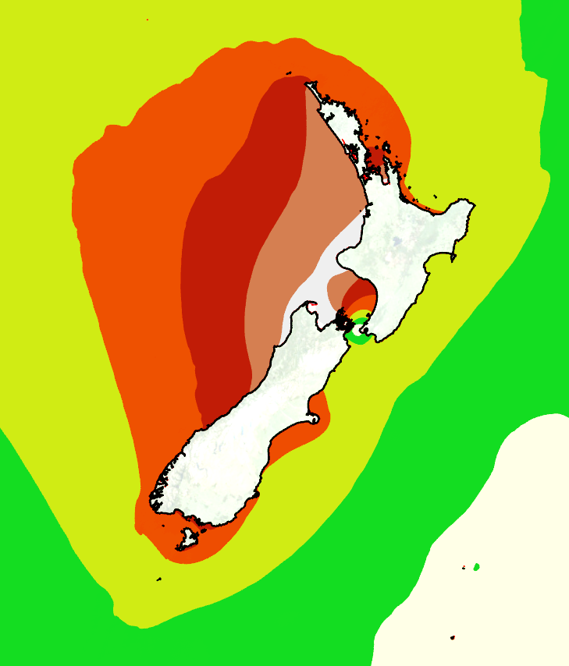
Today’s presentation
Background on vertical datums
The Joining Land and Sea project
MHWS coastline project
Implications for cadastral surveys
Questions and comments

Slide 3
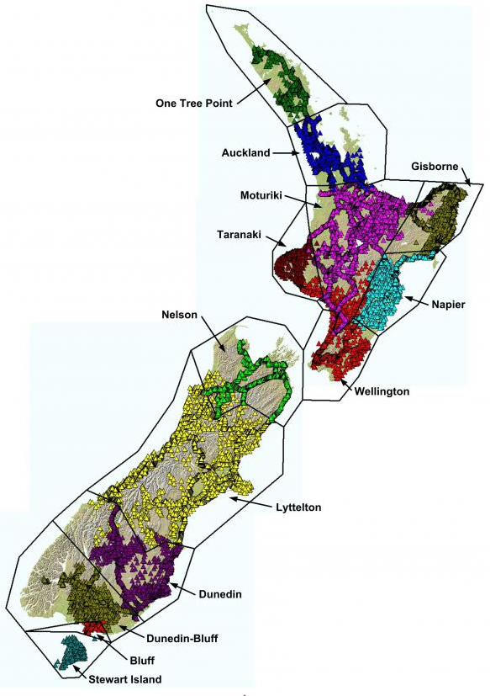
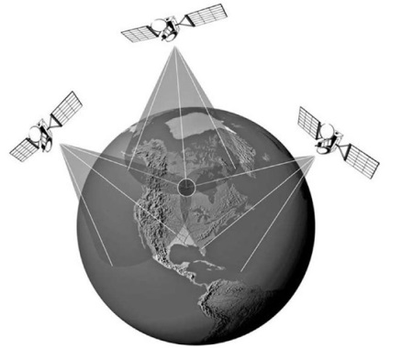
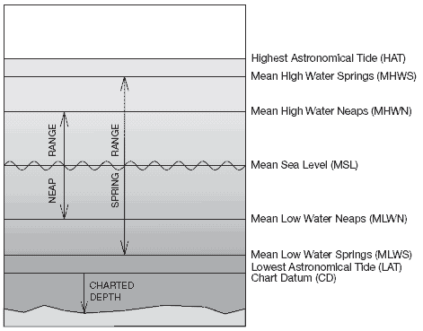
Background
All height/depth data is referenced to a vertical datum
Ellipsoidal Datums – e.g. WGS84, NZGD2000
Orthometric Datums – e.g. Moturiki Vertical Datum-1953
Tidal Levels – e.g. Lowest Astronomical Tides (LAT)
Notes:
All elevation data is referenced to a vertical datum. Three categories of vertical datums are: ellipsoidal datums, orthometric datums, and tidal datums.
Ellipsoidal datums are realized through satellite measurements (GNSS). They are 3-dimensional models that are a simplified mathematical surface that approximates the shape of the earth.
The most widely-recognized ellipsoidal datum is WGS84, however New Zealand has it’s own special ellipsoid, called: NZGD2000.
Tidal datums are calculated from long-term tidal observations. The optimal time span is 19-years, which allows the longest periodic tidal variations to be resolved.
In New Zealand, tidal datums are used in many different sectors: MHWS is used to define cadastral and maritime boundaries; MSL is used to reference terrestrial heights; LAT is used to reference soundings on nautical charts.
One of the issues with tidal datums is that the tidal measurements are taken at discrete locations around the country and therefore do not create a seamless surface.
Orthometric datums are surfaces that approximate MSL. As mentioned above, these have been created at discrete locations around – there are 13 local vertical datums in NZ (for example Moturiki Datum 1953). One issue faced with these datums is that they have been calculated for a certain epoch, which has not considered any sea level change.
NZVD2016 is also an example of an orthometric datum.
Heights can be converted between orthometric and ellipsoid datums using a geoid model – LINZ has recently released the NZGeoid2016.

Slide 4
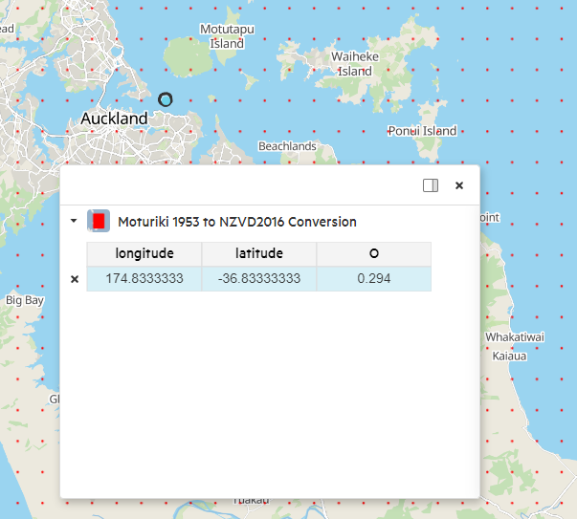
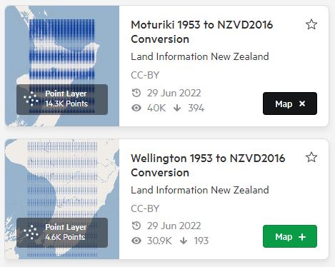
Background
For datasets to be blended together, they must be referenced to the same vertical datum
Conversion grids on the LINZ Data Service
Notes:
In order to join the data, they must be referenced to the same vertical datum – whether it’s the ellipsoid, MSL, NZVD, etc.
Right now, surveyors can translate data collected on, for example, Napier Vertical Datum to Wellington Vertical Datum using the LINZ relationship grids. The nation-wide NZVD2016 (i.e. the geoid) allows height transformations between the ellipsoid and the historical MSL-based vertical datums.

Slide 5
Background
Joining sea-based data and land-based data is more difficult
NZVD 2016
Chart Datum
Notes:
Joining depth data between different charts, or joining depth and height data is a bit more complicated.

Slide 6
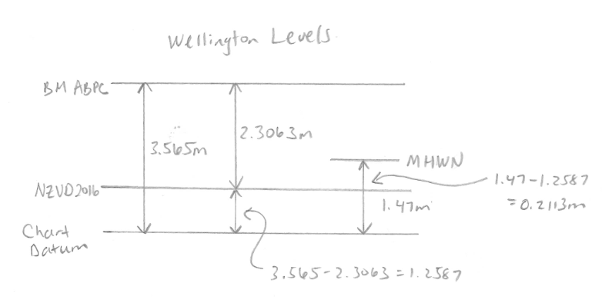
Background
Example: finding MHWN in terms of NZVD2016
Notes:
This is a real-world example of the exercise we go through when having to relate levels, in this case a customer wanted to know MHWN in terms of NZVD2016.
To get to this, we need to refer to:
The geodetic database to get the NZVD2016 level of the benchmark
The chart to get the relation of CD to the BM
The Nautical Almanac to determine what MHWN is at Wellington

Slide 7
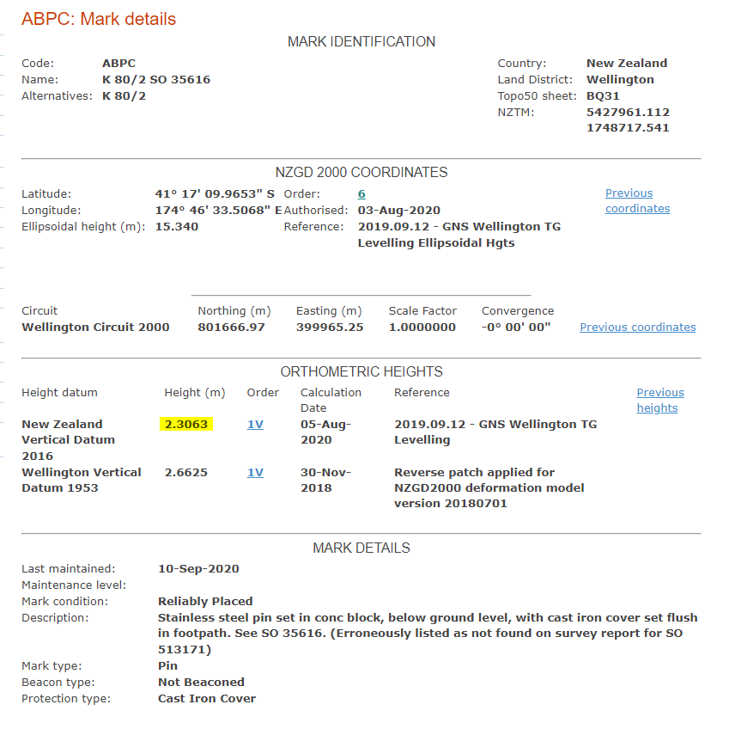
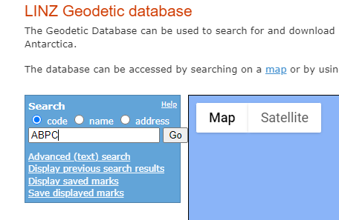
Notes:
This is a real-world example of the exercise we go through when having to relate levels, in this case a customer wanted to know MHWN in terms of NZVD2016.
To get to this, we need to refer to:
The geodetic database to get the NZVD2016 level of the benchmark
The chart to get the relation of CD to the BM
The Nautical Almanac to determine what MHWN is at Wellington

Slide 8
https://www.linz.govt.nz/guidance/marine-information/tide-prediction-guidance
Notes:
This is a real-world example of the exercise we go through when having to relate levels, in this case a customer wanted to know MHWN in terms of NZVD2016.
To get to this, we need to refer to:
The geodetic database to get the NZVD2016 level of the benchmark
The chart to get the relation of CD to the BM
The Nautical Almanac to determine what MHWN is at Wellington

Slide 9
https://www.linz.govt.nz/guidance/marine-information/tide-prediction-guidance
Notes:
This is a real-world example of the exercise we go through when having to relate levels, in this case a customer wanted to know MHWN in terms of NZVD2016.
To get to this, we need to refer to:
The geodetic database to get the NZVD2016 level of the benchmark
The chart to get the relation of CD to the BM
The Nautical Almanac to determine what MHWN is at Wellington

Slide 10
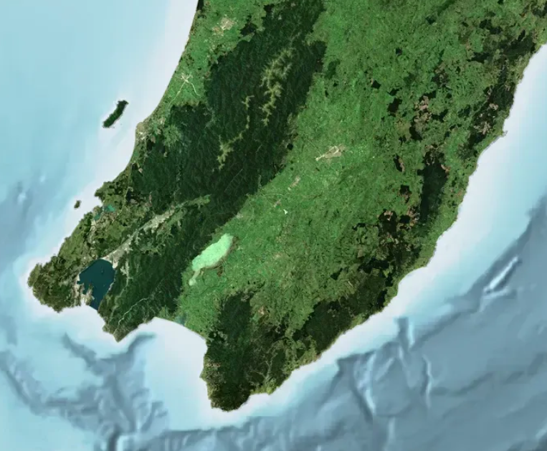
Notes:
We can do this at Wellington, and we can do it at Castlepoint and Mana, but what about any of the locations between these places?

Slide 11
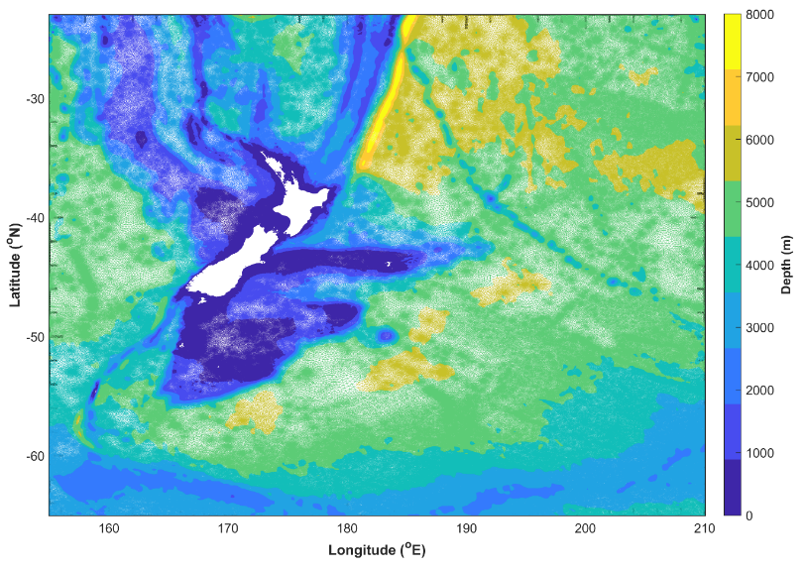
Joining Land and Sea
(JLAS)
New national tidal model
Coastal Link Sites

Slide 12
Tide Model
Oceanographic model produced by NIWA
Tidal surfaces:

Slide 13
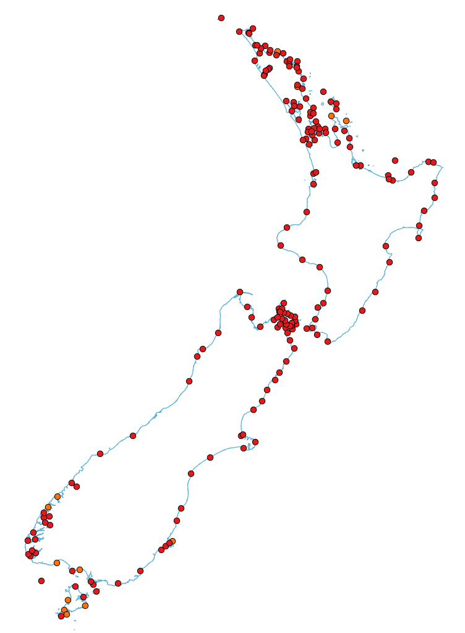
Coastal Link Sites
Used to link tidal surfaces to NZVD2016
Short-term tide gauges
Surveying benchmarks
Notes:
Sea level gauges are the mechanism by which the tidal surfaces are “stitched” (or “linked”) to the land datums.
Ideally, sea level observations are available at a regular spacing along the coastline and are co-located with a datum (i.e. NZVD2016) benchmark. From the data assessment, we found 100 tide stations that were suitable for connection sites.
We will have approximately 200 coastal link sites which will be used to constrain the surfaces and provide reliable interpolation for any point along the coastline.

Slide 14
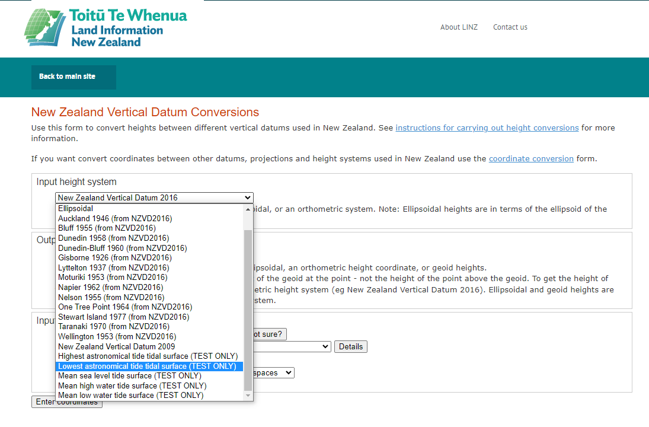
Public Launch
Conversion grids on the LDS
Coordinate converter
Notes:
The Gridded Tidal Surfaces (including accuracy information) will be embedded in the JLAS coordinate converter application and published on the LDS.
These grids can the downloaded from LDS and used in applications like PDAL, GIS programmes.

Slide 15
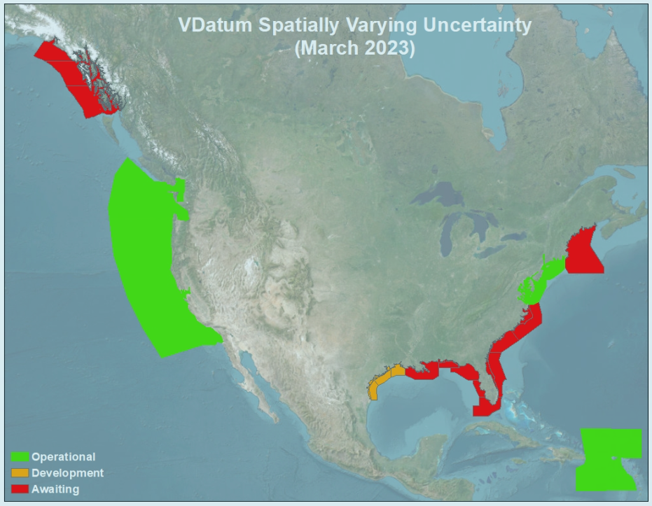
Vertical Uncertainty – JLAS
Sum of errors in: data, models, transformations
Increases with distance from tide gauge
https://vdatum.noaa.gov/docs/est_uncertainties.html#estTidalDatum

Slide 16
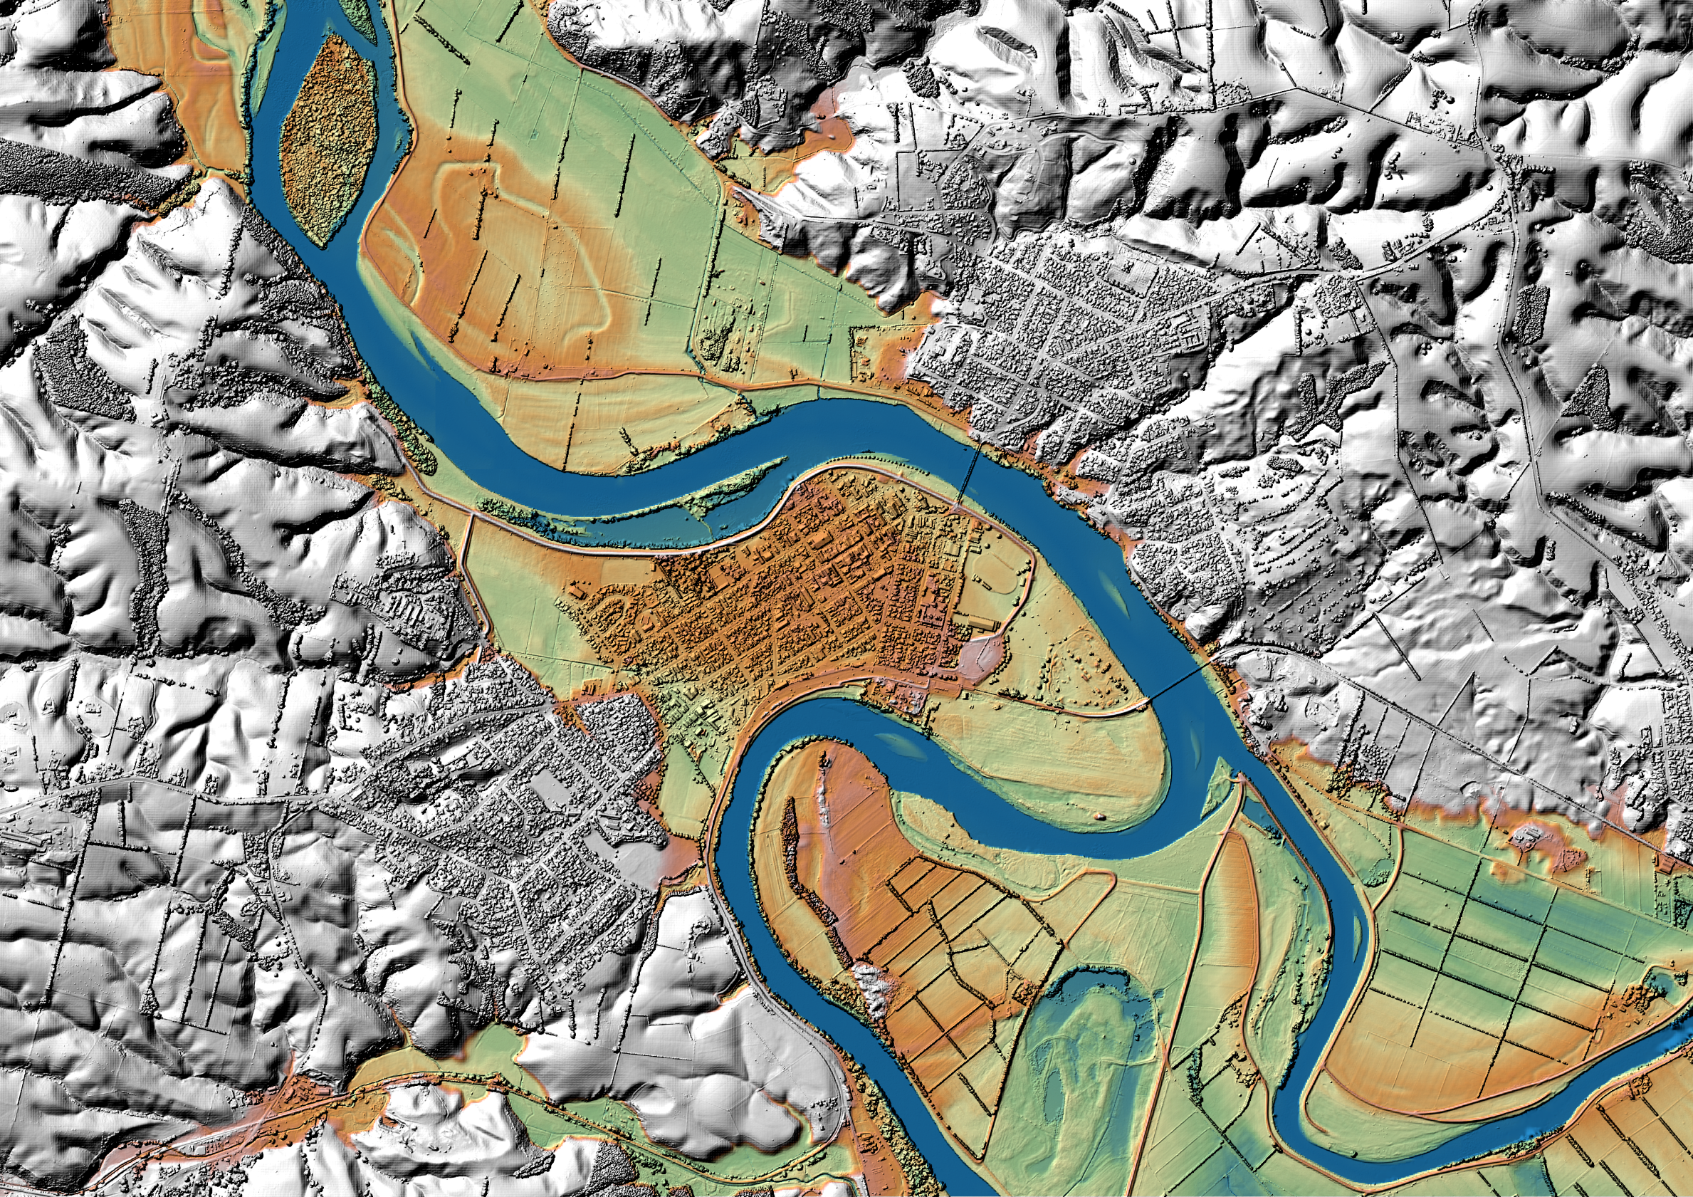
MHWS coastline
Notes:
Before going into detail about the MHWS coastline I like to give you some background on the project itself.
Following the 2016 Kaikōura Earthquake, LINZ was tasked to coordinate the data requirements for multiple agencies and
twelve priority datasets were identified as playing a critical role in decision-making for emergency management namely datasets belonging to (next slide)

Slide 17
Key Datasets - Resilience and Climate Change
Elevation
Aerial Photography
Topographic Map
Coastline
River Network
Water Catchments
Population
Address
Buildings
Property
Road Network
Rail Network
Notes:
People and property (population, buildings, address, property)
Transport (roads and rail)
Rivers and water catchments
Land (elevation, aerial imagery, coastline, topographic maps)
As you can see the coastline is one of those datasets and is one of the datasets LINZ has taken responsibility for.

Slide 18
Published NZ Coastline
Based on Mean High Water
Sourced from topo maps
Attributes from charts
Scale of 1:50,000
Notes:
As a first step to a national coastline dataset, the MHW line depicted on topographic maps was paired with a description of the coastline given on nautical charts, for example, steep coast, mangrove, or stony shore. This line was published in 2020 and is available through the LINZ Data Service. (refer to slide)
For long there has been a desire to have a national coastline based on MHWS and just now data is coming available enabling us to derive this MHWS coastline on a national scale based on models rather than human depiction. Hence this project was started.
The key enabling datasets coming available through a bigger project called “Mapping New Zealand 2025”. You will hear more about it tomorrow during Nic Donnelly’s presentation at 11am. One of those key datasets are the tidal surfaces coming out of JLAS which Jenn just talked about.

Slide 19
Elevation datasets
1m DEMs available in most coastal regions
Vertical accuracy +/- 0.2m
Horizontal accuracy +/- 1m
8m DEM available for all NZ
Chatham Islands no DEMs yet
LiDAR coverage 2024
Notes:
Other key datasets coming available now are high resolution digital elevation models.
LINZ has focused on capturing LiDAR data for all of New Zealand over the last years and digital elevation models will be available for 80% of New Zealand by 2024. (refer to image)
In areas where we do not have LiDAR coverage, we are intending to use the 8m DEM based on 20m contours.
Unfortunately, there is neither LiDAR coverage nor an 8m DEM available for the Chatham Islands.
This is where another project under the Mapping New Zealand 2025 umbrella comes into play. This project just received funding to capture 85% of New Zealand's coast including the Chatham Islands. The proposed technology is LiDAR and the aim is to mapp the coastal strip both land and sea. This dataset will not only be of use to derive a MHWS line for the Chatham Islands but will also help refining the coastline around New Zealand. Again more information on this particular project tomorrow at 11am.

Slide 20
MHWS coastline delineation concept
Digital Elevation Model (from LiDAR)
Notes:
Coming to the concept of the delineation of the coastline.
The line of ‘MHWS” will be determined by:
Generating a shore profile form Digital Terrain Models
Using the vertical height of the MHWS level provided through the JLAS project surfaces
and then
projecting that height onto the shore profile to determine the horizontal location of the MHWS contour.

Slide 21
MHWS coastline delineation concept
MHWS
Coastline
Tidal Surface
(Mean High Water Springs)
Digital Elevation Model (from LiDAR)
Notes:
The aim is to automate this process to enable us to run this process each time new LiDAR data comes available or the tidal surface get’s updated.

Slide 22
Process - Buffered DEM
Elevation data downloaded from LDS
Buffer of 5km applied to reduce file size
Datasets merged and metadata preserved in separate polygons
Notes:
LiDAR datasets give you great detail, but this comes at a cost in file size. To make the process smoother, we decided to reduce the size of the elevation data by setting a buffer based on the published MHW coastline.
Once the elevation data is clipped, we merge all available datasets together to create a seamless band along the coast which then gives us the elevation base dataset. During this process metadata information from the LiDAR surveys is preserved in a separate polygon file at the moment. It is still to be decided how this information will be published along with the coastline.

Slide 23
Process – Coastline delineation pilots
First pilot almost 20 years ago
Concept tested in ArcPro
Awaiting JLAS output to refine process
Notes:
Slide notes..
Several pilots have been run to test the process of deriving a coastline based on intersecting an elevation model and a tidal surface or tidal plane. On the right you see another output of a pilot run a few years ago. It shows Mount Maunganui's Main Beach and Moturiki Island. The line in black is the derived MHWS coastline and in orange represents the cadastral boundaries. As you can see there is quite a difference between the two in this instance.
Stacey will now talk about the use of the MHWS Coastline in Cadastral Surveying.

Slide 24
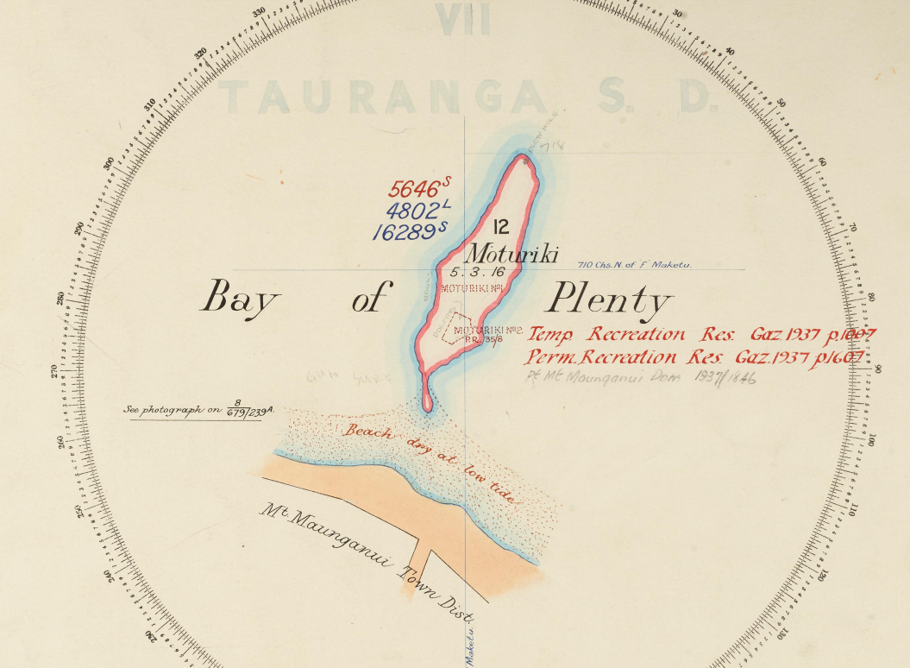
Implications for Cadastral Surveys
Notes:
When undertaking a cadastral survey there are times when you need to determine where the position of mean high water springs is.
These include any of the following that are in the coastal area:
A subdivision of land under the Resource Management Act 1991
A legalisation plan where privately owned land is being taken for road or other public works
A survey of Crown or Local Authority land where the land below MHWS became common marine and coastal area when the Marine and Coastal Area (Takutai Moana) Act 2011 came into force.
Land in a title that was affected by the Manukau Harbour Control Act 1911
For defining marine reserves or Customary Marine Titles
The starting point to determining whether the MHWS coastline can be used in the specific circumstance will be to consider the required level of accuracy.

Slide 25
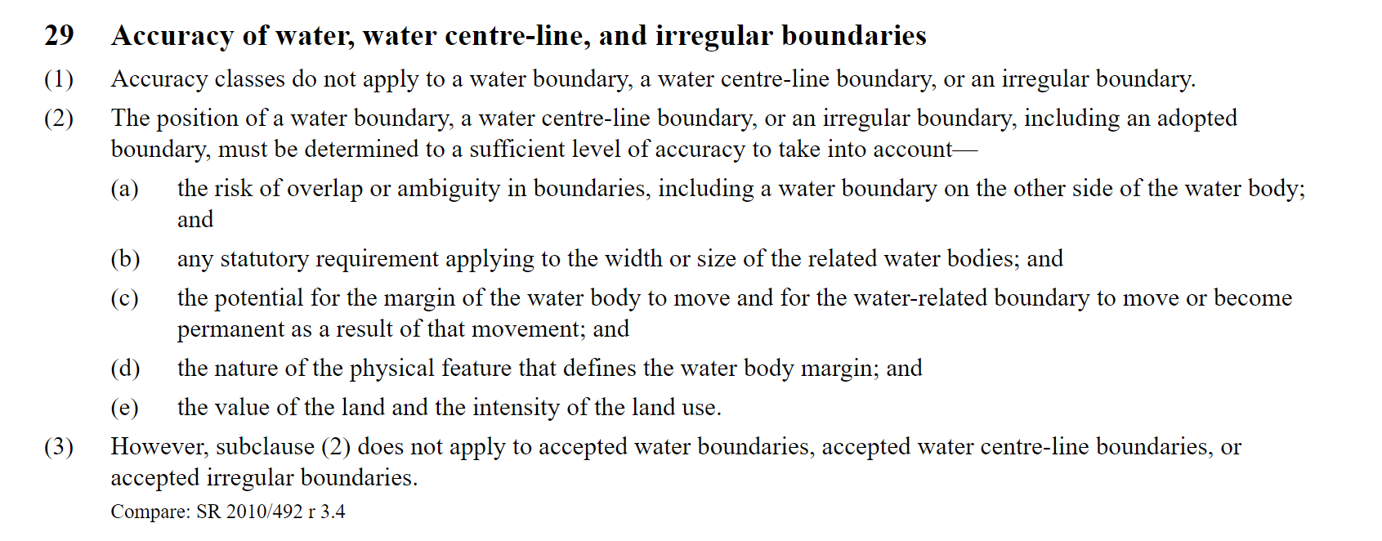
Accuracy of water boundaries:
Notes:
The accuracy of water boundaries is covered by rule 29 of the Cadastral Survey Rules 2021.
I know that surveyors often prefer to have a set dimension to work to for accuracy tolerances. However, the way that this rule has been set gives you the opportunity to determine what you consider the accuracy requirements are for each specific situation.
Rule 29(2) requires the position of a water boundary to be determined to a sufficient level of accuracy to take into account—
(a) the risk of overlap or ambiguity in boundaries, including a water boundary on the other side of the water body; and
(b) any statutory requirement applying to the width or size of the related water bodies; and
(c) the potential for the margin of the water body to move and for the water-related boundary to move or become permanent as a result of that movement; and
(d) the nature of the physical feature that defines the water body margin; and
(e) the value of the land and the intensity of the land use.
The accuracy will be important for not only ensuring that rule 29(2) is met but also for ensuring parcels such as esplanade reserves are in the correct place, and that any parcels of land below MHWS required to be removed from a parcel are depicted correctly.
Once you’ve got a sense of the level of accuracy required based on those aspects, you’ll need to determine whether you consider the MHWS Coastline is accurate enough to be used, and what role it plays.

Slide 26
MHWS coastline delineation concept
MHWS
Coastline
Tidal Surface
(Mean High Water Springs)
Digital Elevation Model (from LiDAR)
Notes:
You’ve seen this diagram earlier when Annette explained that the MHWS coastline will be determined by:
Generating a shore profile from Digital Terrain Models
Using the vertical height of the MHWS level provided through the JLAS project surfaces
and then
projecting that height onto the shore profile to determine the horizontal location of the MHWS contour.
As Jennifer has discussed, there will be a level of vertical uncertainty in the MHWS coastline that is based on the sum of errors in: data, models, transformations and that increases with distance from tide gauge.
When it comes to cadastral surveying we are usually concerned about the horizontal extent/depiction of MHWS. Therefore we need to understand what horizontal uncertainty will result from the vertical uncertainty.
We don’t know what the accuracy is going to be at the moment and will be providing you with the levels of uncertainty once the tool is in place.
We do know that the horizontal accuracy is going to be different based on aspects such as the slope of the beach. On a flat beach a vertical uncertainty of 20cm could mean a horizontal uncertainty of 20m which could be significant.
Which means in terms of the diagram, the horizontal accuracy of the MHWS coastline might be better represented with a much thicker line.

Slide 27
MHWS coastline accuracy
MHWS
Coastline
Tidal Surface
(Mean High Water Springs)
Digital Elevation Model (from LiDAR)
Notes:
We think this will be a useful tool for surveyors, but you will have to make your own judgement to see if it is fit for purpose in the area you are working.
You will need to consider aspects such as
the slope of the beach
The date that the latest MHWS coastline was determined and the likelihood of the beach profile changing since that date
The nature of the beach – e.g. is it a rocky coastline, sandy beach, is it covered with vegetation?
You could validate the MHWS Coastline position by comparing it against aerial photography
– if the beach is rocky does the depicted MHWS coastline go in and out around the rocks to like you would expect it to or has the depiction been generalised when the line was created?
Another method to use would be to setout the MHWS coastline with GNSS on the beach with and see how it looks.
You may find that there are situations where the MHWS coastline is of adequate accuracy to be used. An example could be when a large farm adjoining the coast in a remote area is being subdivided and the position of MHWS is required so that the land below it can become common marine and coastal area.
There may be other situations for higher value land where you can use the MHWS coastline in conjunction with other surveying techniques to determine the position of MHWS.
And there may be further situations where a combination of factors means that it is not appropriate to use the MHWS Coastline for a specific cadastral survey.
As always, your reporting on the decisions that you have made will be important so that current and future users of your dataset can understand the decisions you have made.
In terms of MHWS, one thing I want to note at this point is that using this line could give a drastically different position of MHWS when compared with the underlying survey of the parcel concenred. This is because in the past, there have been various techniques used to determine coastal boundaries. These have included taking the line of vegetaion, the line of dritwood or the toe of a bank. If you use the MHWS Coastline to determine the current MHWS position and it is a lot further seaward than the current parcel boundary, you are going to have to decide whether the difference is due to changes that have occurred over time, or whether the old survey was inaccurate. If the old survey is determined to be inaccurate you will have to look into whether you think there is a case for a better survey fix. If the existing parcel boundary is MHWM you’ll have to do the better survey fix to the current MHWM position to account for the whole of the underlying parcel and then create the new boundary at MHWS to fulfil the requirements of the current survey. You can find information about what you need to consider when doing a better survey fix in the Water Boundaries section of the Cadastral Survey Guidelines.

Slide 28
Resources
Cadastral Survey Guidelines – Water boundaries
Cadastral Survey Guidelines - Tidal boundaries
Marine reserves or customary marine titles
Tidal level information for surveyors
Notes:
Which leads me to my next slide.
Before I conclude, I’ve listed some water boundary resources that you might like to take a look at.
The first three are parts of the Cadastral Survey Guidelines that we published when the Cadastral Survey Rules 2021 were rolled out
Topics that are covered include:
accretion, erosion, avulsion, dried bed
accepting/adopting/defining by survey
depiction of water boundaries in various circumstances
Accounting for the whole of a parcel
Determining whether land has become common marine and coastal area or is required to become common marine and coastal area as a result of the current survey.
Various scenarios of how any land that has become or will become common marine and coastal area must be depicted on a cadastral survey dataset.
And the final link is to a page that comments on some of the different techniques used to determine MHWS and provides a table of predicted tidal levels at the New Zealand standard ports.
I anticipate that when the MHWS Coastline is available for use we will be updating our guidance, including to provide some of the information discussed in today’s presentation. Surveyors will also be able to contact Toitū Te Whenua Land Information New Zealand if they have questions once the MHWS Coastline is released and they are using it.

Slide 29
Final thoughts
JLAS will help merge elevation datasets
The concept of the MHWS process can be applied to derive other coastlines like MSL, MHW or MLWS
The position of MHWS may be able to be used in cadastral surveys, subject to meeting the accuracy requirements.

Slide 30
Questions/Comments?

