Slide 1


Rising to the Infrastructure Challenge
Survey and Spatial New Zealand Conference
Geoff Cooper - GM Strategy, Te Waihanga
September 1st 2023

Slide 2


Infrastructure is about movement

Slide 3
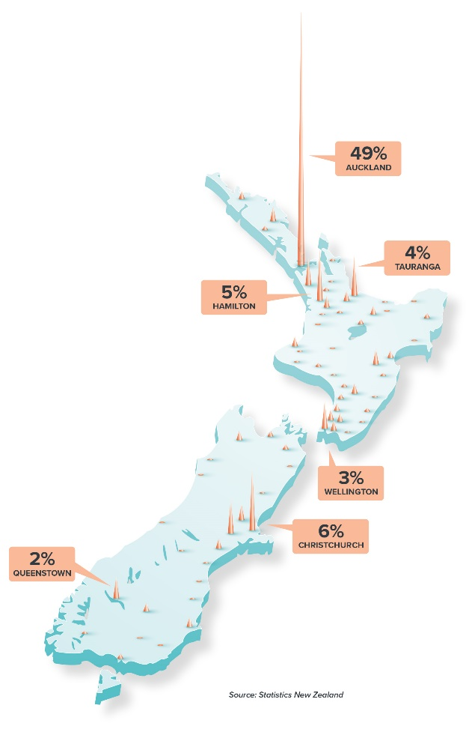
1. More people. More infrastructure
1. Growth

Slide 4
But predicting the future is highly uncertain
Historical population – actual vs. projections
Actual population
Projections from 1952-1971
1. Growth
Projections
from 1976-1982

Slide 5
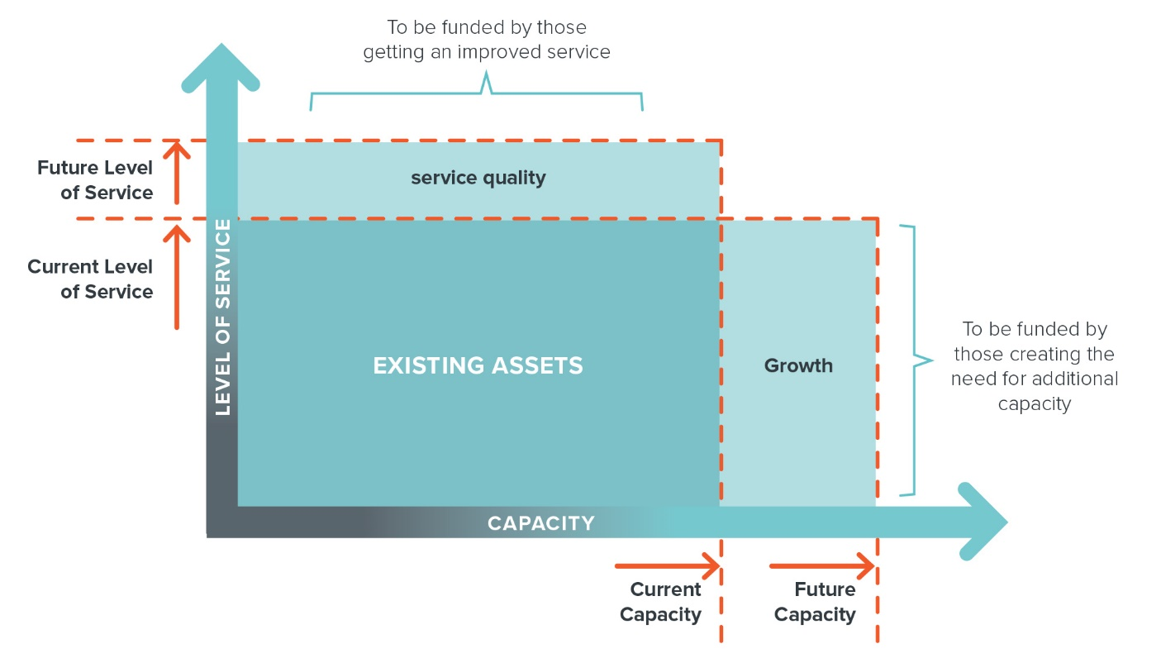
2. Higher incomes, higher expectations
To be funded by those getting an improved service
Future Level of Service
service quality
Current Level of Service
2. Levels of service
To be funded by those creating the need for additional capacity
EXISTING ASSETS
Growth
CAPACITY
Current Capacity
Future Capacity

Slide 6
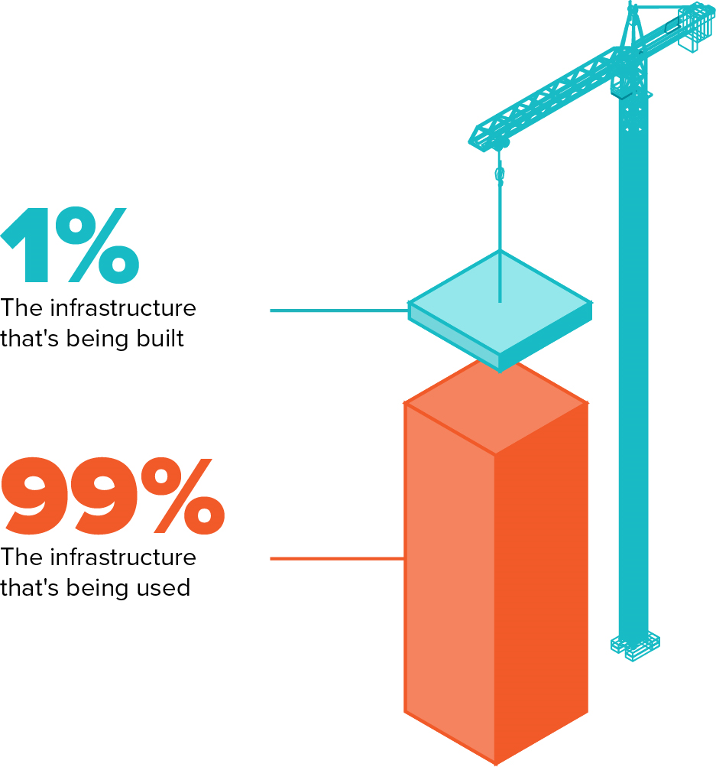
3. Maintenance: Looking after what we have
Our future welfare and livelihoods depend increasingly on the less glamorous work of improving our existing infrastructures.
Scotland Infrastructure Commission

Slide 7
Infrastructure comes with an obligation
Local government renewals
Ratios under 1.0 indicate potential under-funding of renewals
3. Renewals
Source: https://www.localcouncils.govt.nz/lgip.nsf/wpg_URL/Resources-Download-Data-Local-authority-long-term-plans

Slide 8

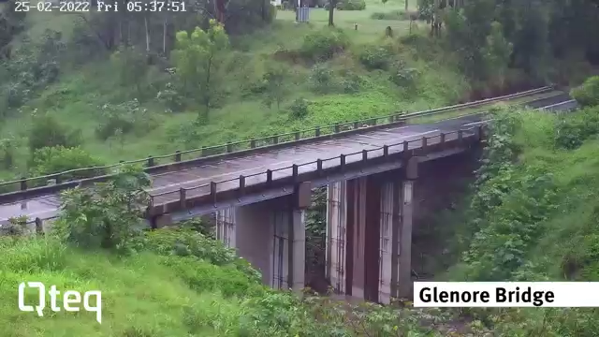
4. Resilience: Meeting new demands
Sea levels are rising
And annual exceedance probabilities are increasing
4. Resilience

Slide 9
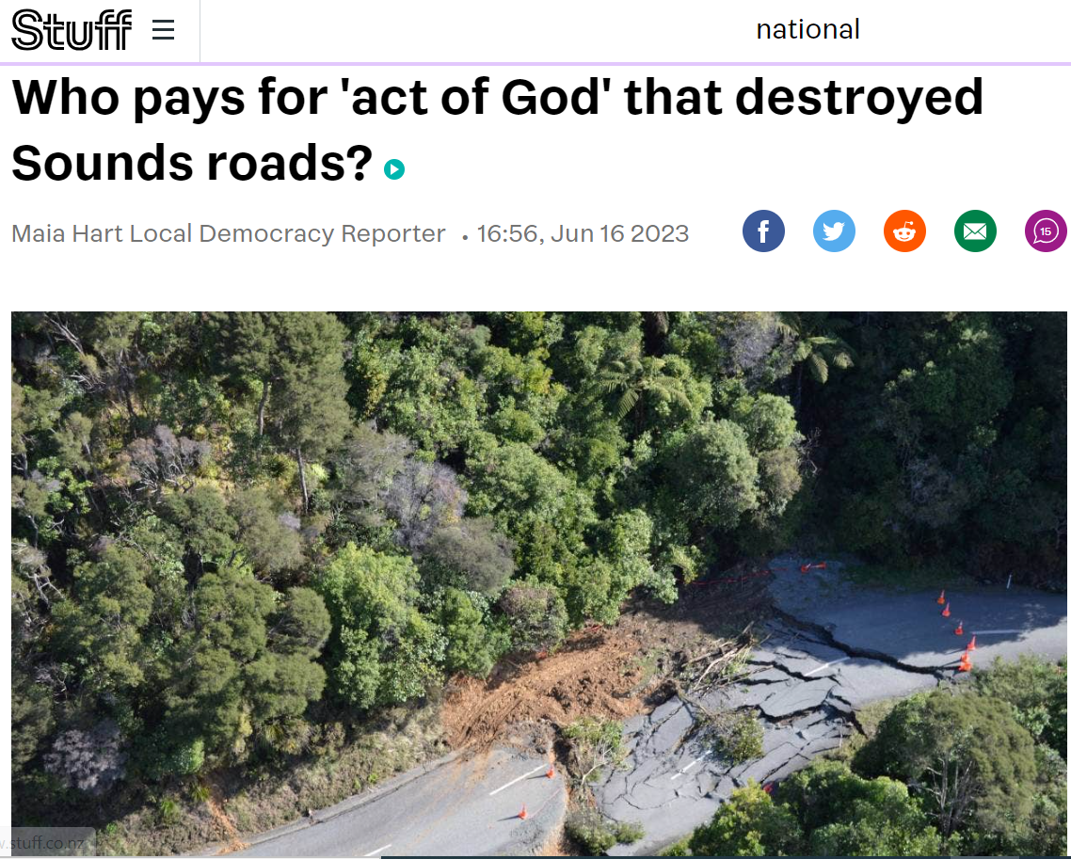
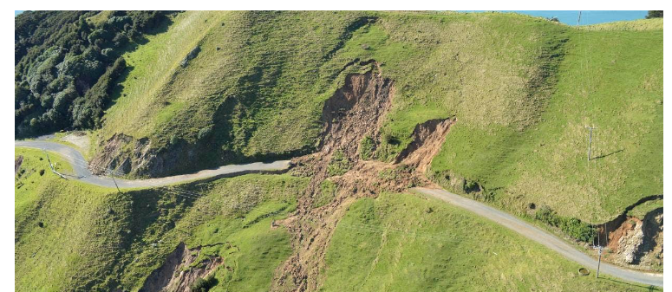

Against a changing and uncertain future
Case study: Risk of stopbank failure
But who will pay?
$$Failure probability=1−{(1−AEP)}^{Years}$$
Risk levels we expected over 50 years could arise within 20 years
Equal to 20 years of normal road maintenance spending in Marlborough District
Adapted from https://www.tewaihanga.govt.nz/assets/Belinda-Storey-Time-to-Failure-in-Infrastructure.pdf

Slide 10
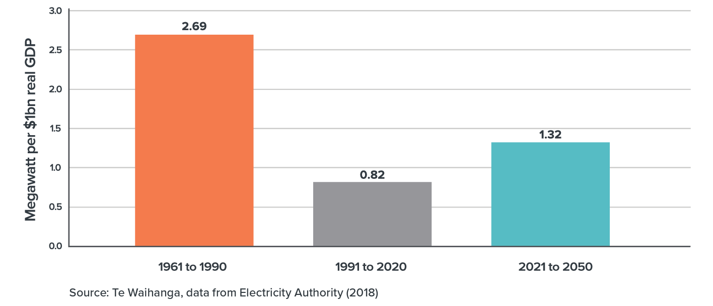
5. Meeting infrastructure needs for net zero 2050
Historical and projected growth in electricity generation capacity, relative to GDP
But we’ve done it before
5. Net zero

Slide 11
The Infrastructure Challenge

Slide 12
We will need to double our efforts
1.6%
9.6%
4.6%
The Infrastructure Challenge
Indicative future costs (% of GDP)
THE RESPONSE
OUR INFRASTRUCTURE CHALLENGE
2.7%
0.7%
+
+
+
=
Make better use of
existing infrastructure
+
+
+
+
Existing
plans
Current infrastructure deficit
Future infrastructure needs
Renewals
Cost pressures
What’s needed
Better project selection
Broaden funding
and financing
Streamline delivery

Slide 13
A pipeline in three parts
Overall Portfolio
Infrastructure Needs Assessment:
Long term needs not yet in planning
Investment scale
Infrastructure Priority List:
Unfunded projects in planning
National
Infrastructure
Pipeline:
Funded projects
Time

Slide 14

Balancing flexibility and certainty
Demand side levers
Decision making on:
Funding prioritisation, coordination, sequencing
System Settings
Supply side levers
Policy settings for:
Employment, Education,
Training, Immigration
Demand stakeholders:
Infrastructure providers
(eg Waka Kotahi)
Supply stakeholders:
Construction sector and supply chain
(eg Downer Group)
Desires flexibility and market capacity to respond to infrastructure investment needs
Te Waihanga
Informs and facilitates improved planning and coordination within the construction market and informs decision making on funding and system settings
Desires longer term certainty
and a smooth Pipeline to
invest and build capability
and capacity

Slide 15
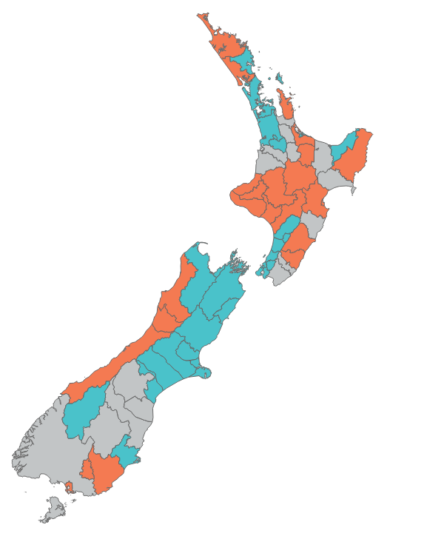
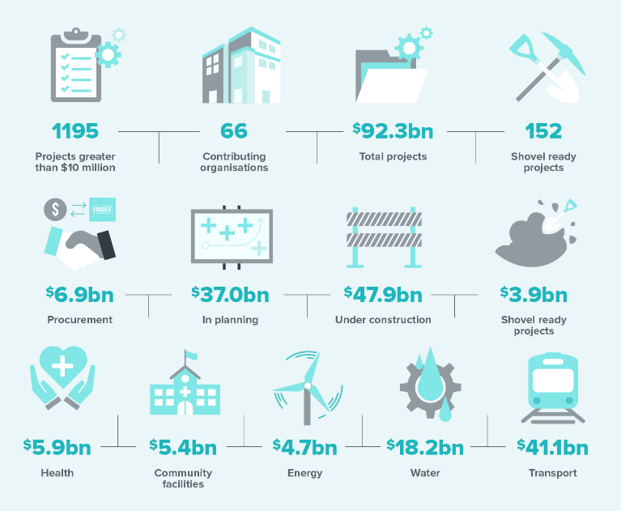
A facilitation tool
Council contributors – direct information (green) indirect and partial information (orange)

Slide 16
Pipeline certainty
What gives us certainty?
 | More certainty | Less certainty
Planning | Broad consensus on problem definition, preferred option and need. High growth locations Announcement after business case | Contestability on problem definition, preferred option and need. Low growth, declining locations Announcement before business case
Funding | User chargers Pricing autonomy | Fixed or centralized funding Rigid/political prices
Complexity | Small works Modular, standardized Able to import knowledge Maintaining the status quo (maintenance, reinstatement, resilience) | Megaprojects High complexity, bespoke, site-specific Need to develop local knowledge Challenging the status quo (New capital assets)
Workforce | Requires relatively small workforce from a global pool | Requires large workforce from a domestic pool
Institutions | Regulated entities | Local Government
6. Land | Land protection undertaken | Land acquisition required
Determinants of certainty

Slide 17
Pipeline certainty
What gives us certainty?
 | More certainty | Less certainty
Planning | Broad consensus on problem definition, preferred option and need. High growth locations Announcement after business case | Contestability on problem definition, preferred option and need. Low growth, declining locations Announcement before business case
Funding | User chargers Pricing autonomy | Fixed or centralized funding Rigid/political prices
Complexity | Small works Modular, standardized Able to import knowledge Maintaining the status quo (maintenance, reinstatement, resilience) | Megaprojects High complexity, bespoke, site-specific Need to develop local knowledge Challenging the status quo (New capital assets)
Workforce | Requires relatively small workforce from a global pool | Requires large workforce from a domestic pool
Institutions | Regulated entities | Local Government
6. Land | Land protection undertaken | Land acquisition required
Determinants of certainty

Slide 18
Pipeline certainty
What gives us certainty?
 | More certainty | Less certainty
Planning | Broad consensus on problem definition, preferred option and need. High growth locations Announcement after business case | Contestability on problem definition, preferred option and need. Low growth, declining locations Announcement before business case
Funding | User chargers Pricing autonomy | Fixed or centralized funding Rigid/political prices
Complexity | Small works Modular, standardized Able to import knowledge Maintaining the status quo (maintenance, reinstatement, resilience) | Megaprojects High complexity, bespoke, site-specific Need to develop local knowledge Challenging the status quo (New capital assets)
Workforce | Requires relatively small workforce from a global pool | Requires large workforce from a domestic pool
Institutions | Regulated entities | Local Government
6. Land | Land protection undertaken | Land acquisition required
Determinants of certainty

Slide 19
Pipeline certainty
What gives us certainty?
 | More certainty | Less certainty
Planning | Broad consensus on problem definition, preferred option and need. High growth locations Announcement after business case | Contestability on problem definition, preferred option and need. Low growth, declining locations Announcement before business case
Funding | User chargers Pricing autonomy | Fixed or centralized funding Rigid/political prices
Complexity | Small works Modular, standardized Able to import knowledge Maintaining the status quo (maintenance, reinstatement, resilience) | Megaprojects High complexity, bespoke, site-specific Need to develop local knowledge Challenging the status quo (New capital assets)
Workforce | Requires relatively small workforce from a global pool | Requires large workforce from a domestic pool
Institutions | Regulated entities | Local Government
6. Land | Land protection undertaken | Land acquisition required
Determinants of certainty

Slide 20
Pipeline certainty
What gives us certainty?
 | More certainty | Less certainty
Planning | Broad consensus on problem definition, preferred option and need. High growth locations Announcement after business case | Contestability on problem definition, preferred option and need. Low growth, declining locations Announcement before business case
Funding | User chargers Pricing autonomy | Fixed or centralized funding Rigid/political prices
Complexity | Small works Modular, standardized Able to import knowledge Maintaining the status quo (maintenance, reinstatement, resilience) | Megaprojects High complexity, bespoke, site-specific Need to develop local knowledge Challenging the status quo (New capital assets)
Workforce | Requires relatively small workforce from a global pool | Requires large workforce from a domestic pool
Institutions | Regulated entities | Local Government
6. Land | Land protection undertaken | Land acquisition required
Determinants of certainty

Slide 21
Pipeline certainty
What gives us certainty?
 | More certainty | Less certainty
Planning | Broad consensus on problem definition, preferred option and need. High growth locations Announcement after business case | Contestability on problem definition, preferred option and need. Low growth, declining locations Announcement before business case
Funding | User chargers Pricing autonomy | Fixed or centralized funding Rigid/political prices
Complexity | Small works Modular, standardized Able to import knowledge Maintaining the status quo (maintenance, reinstatement, resilience) | Megaprojects High complexity, bespoke, site-specific Need to develop local knowledge Challenging the status quo (New capital assets)
Workforce | Requires relatively small workforce from a global pool | Requires large workforce from a domestic pool
Institutions | Regulated entities | Government
6. Land | Land protection undertaken | Land acquisition required
Determinants of certainty

Slide 22
Workforce is critical to execution
Construction labour shortages are at their highest since 1975
“One of the biggest challenges [to meeting net-zero carbon targets] is going to be skills … The world is going to be queueing up on the skillsets that are needed. So we better double down on training our own and we better figure out where to get the skills from to get it done … or we’ll have the strategy, we’ll have the finance, we’ll have the vision, but we will fall woefully short on execution.”
- Dr Rod Carr

Slide 23
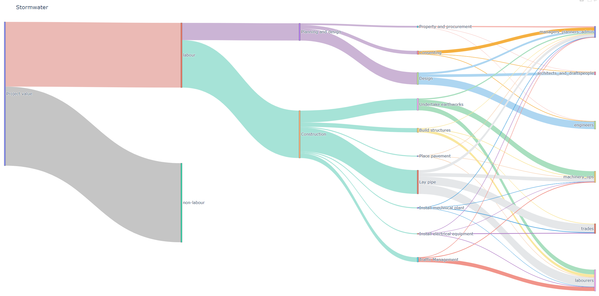
Stormwater project (example)
Workforce costs
But how well do we understand it?
Planning | Construction
Project stage/tasks
Occupations

Slide 24
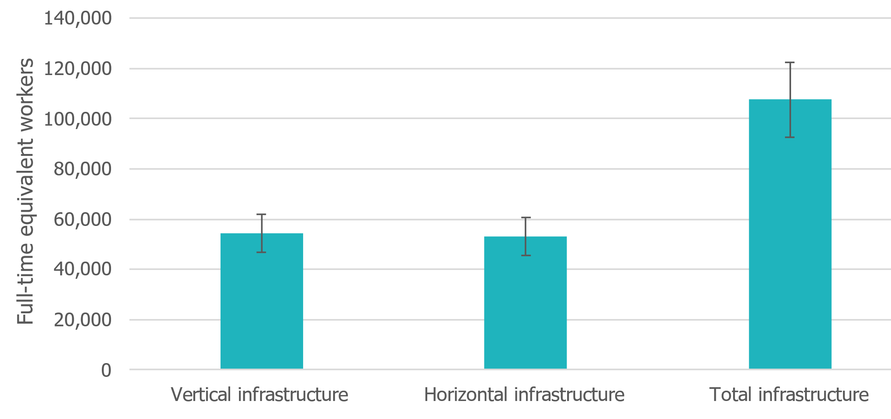
How large is the infrastructure workforce?
Preliminary Results
In 2018, there were over 100k FTE workers
Two thirds of the workforce is in Auckland, Waikato, Wellington and Canterbury

Slide 25
Ten occupations account for half the workforce
Preliminary Results

Slide 26
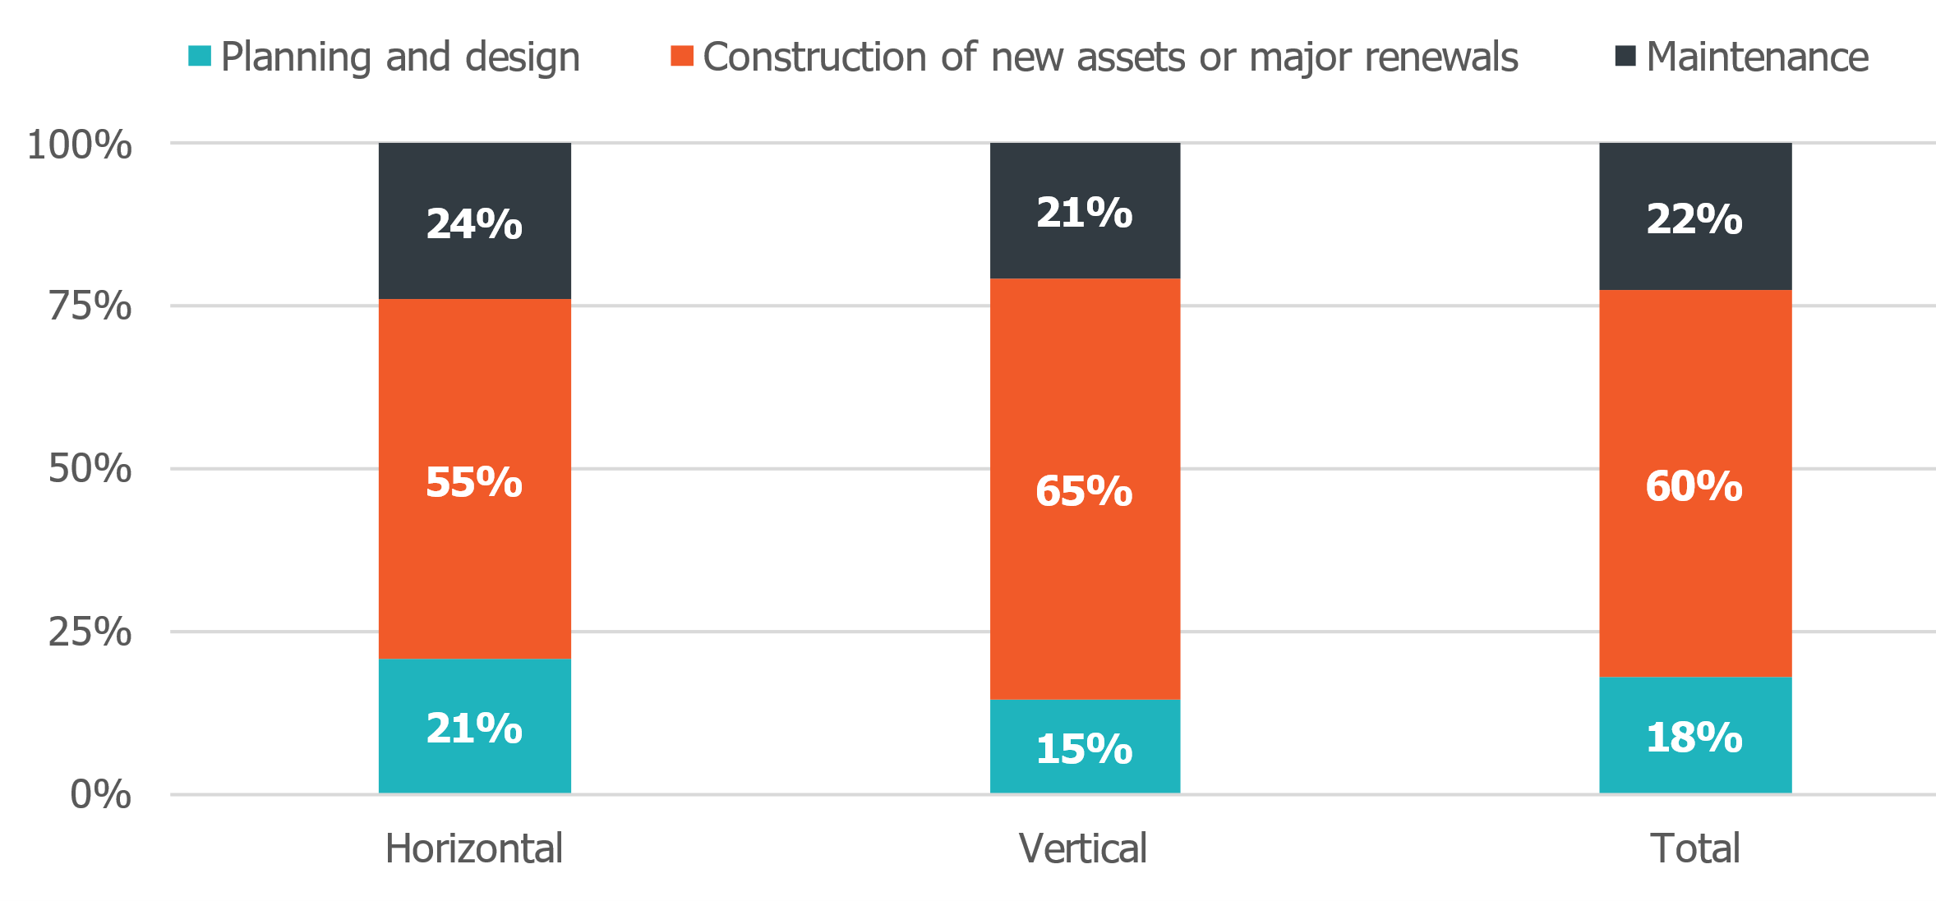
What are people working on?
Preliminary Results

Slide 27
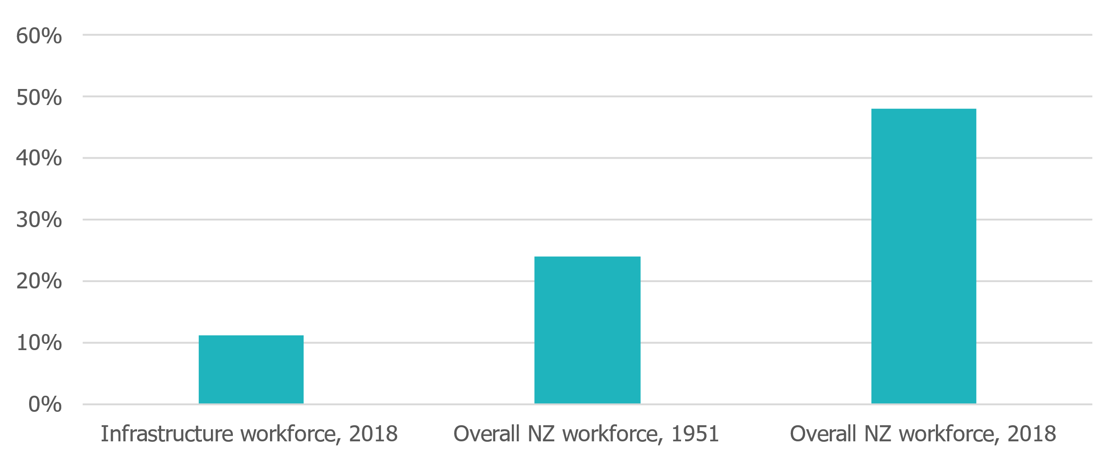
Workforce diversity
Preliminary Results
Female participation is low

Slide 28
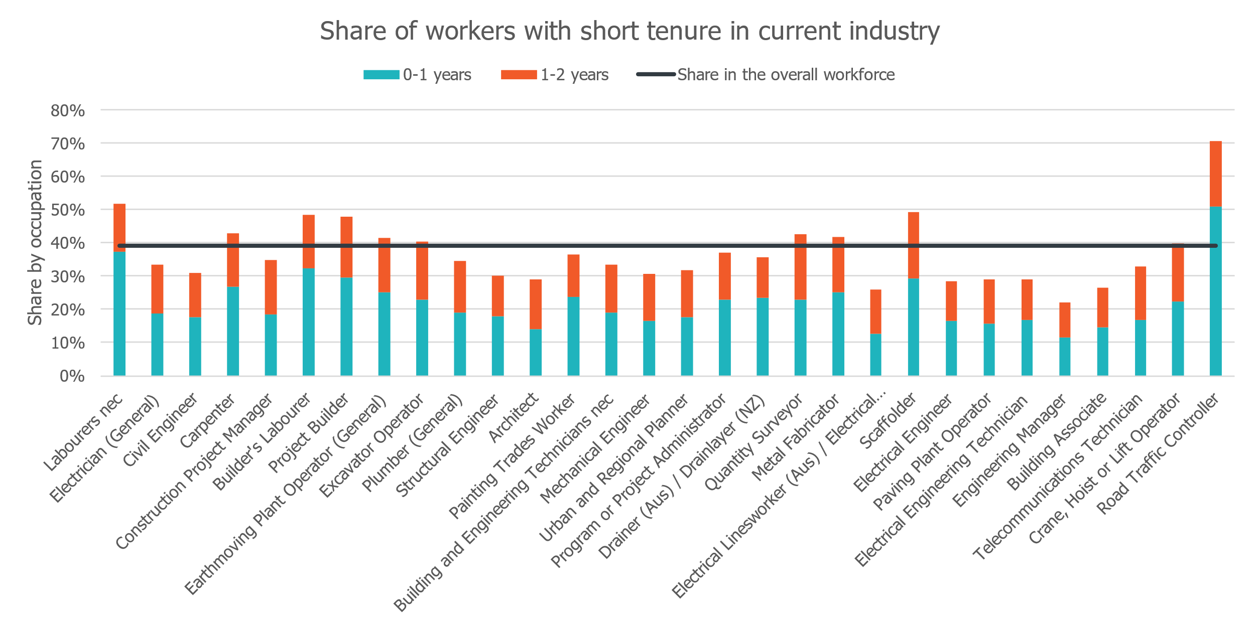
What pathways do people follow?
Preliminary Results
Four in ten workers recently entered current industry

Slide 29
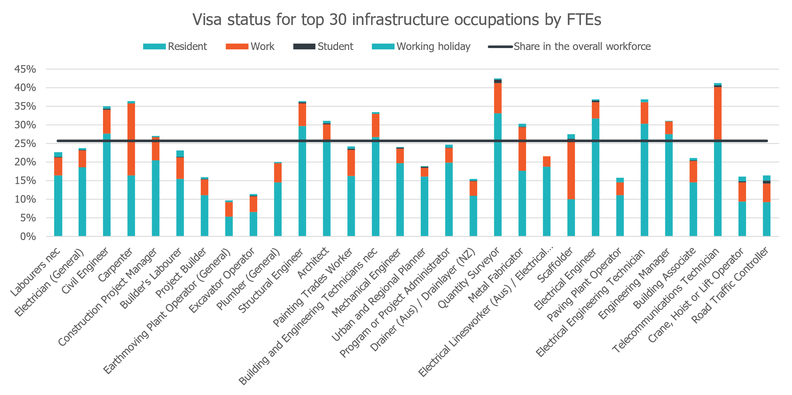
What pathways do people follow?
Preliminary Results
One in four workers is on a visa

Slide 30
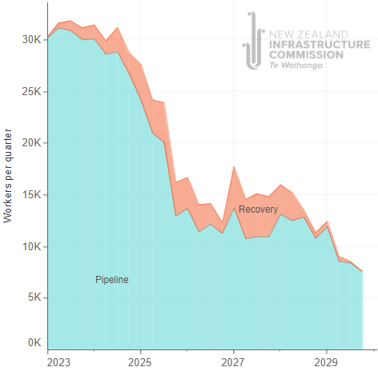
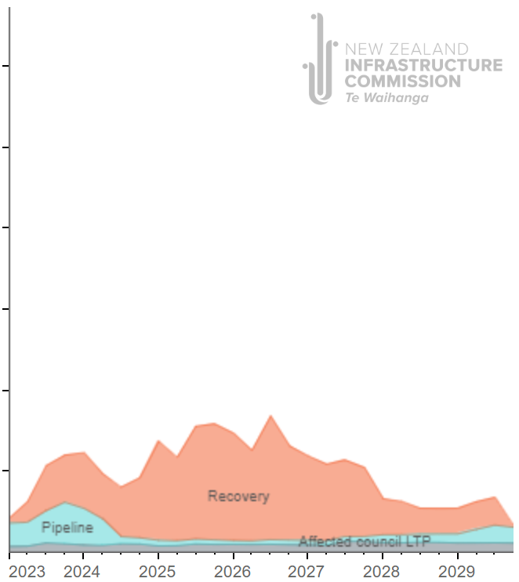
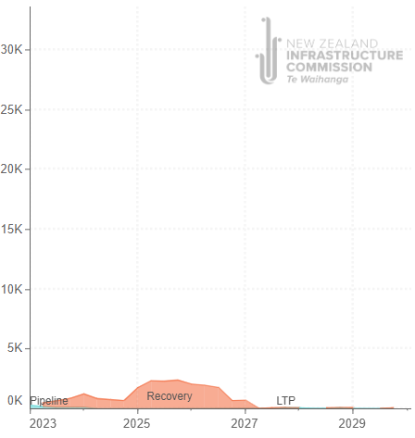
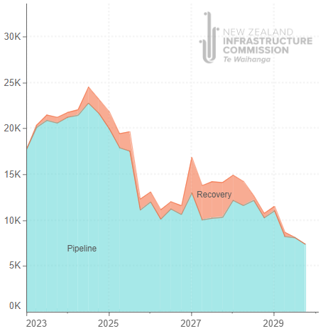
Workforce challenges differ across regions
Auckland
Hawkes Bay
Tairāwhiti
Known baseline:
Existing planned and funded activity
Notes:
Kainga Ora, MOE, Health, Corrections etc removed with building

Slide 31
Megaprojects reverberate
Historical and Projected Transportation Capital Spend in Auckland
Megaprojects
The planned portfolio of interrelated transportation projects in Auckland is of an unprecedented scale, with required annual capital spend over three times the historical annual maximum
Notes:
Kainga Ora, MOE, Health, Corrections etc removed with building

Slide 32
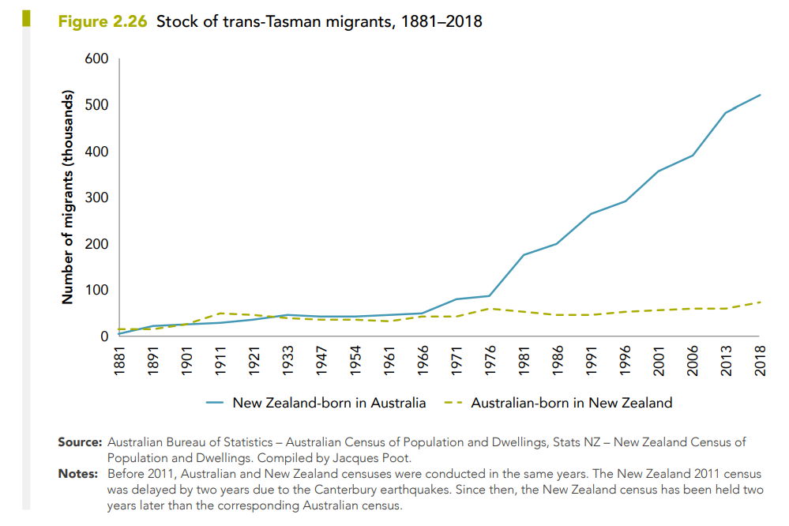
New Zealand must compete for talent
“Australia’s pipeline consists of 364 projects valued at $639 billion”
Competition
Notes:
Kainga Ora, MOE, Health, Corrections etc removed with building

Slide 33
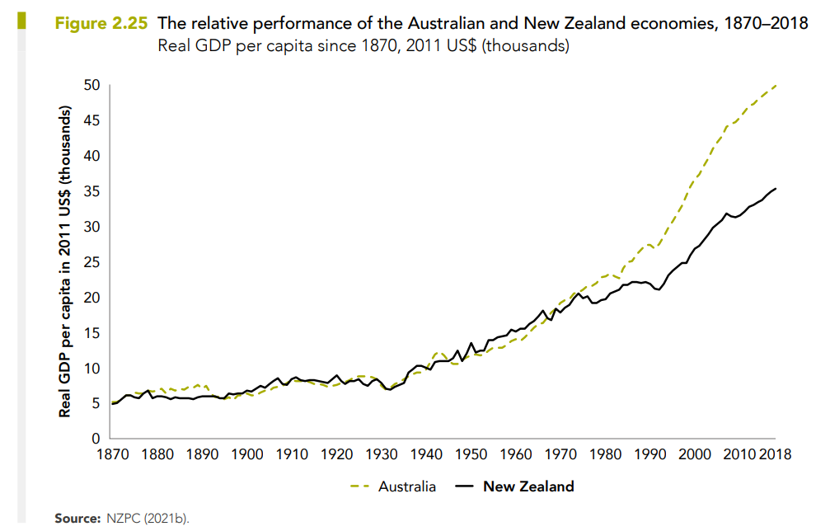
Which means wages and productivity are critical
Productivity
Notes:
Kainga Ora, MOE, Health, Corrections etc removed with building

Slide 34
And so is housing affordability …
Housing Affordability
Notes:
Kainga Ora, MOE, Health, Corrections etc removed with building

Slide 35
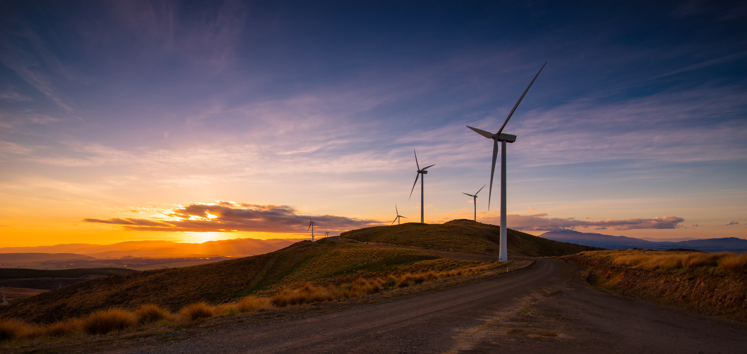
New Zealand will need significant new investment in infrastructure
But that doesn’t necessarily translate into certainty about what, where and when we invest.
System setting improvements can help: Planning, funding, workforce, project choices, institutions, land
And sometimes we need to preserve optionality and flexibility
But workforce may be the most significant binding constraint

